Slide 1
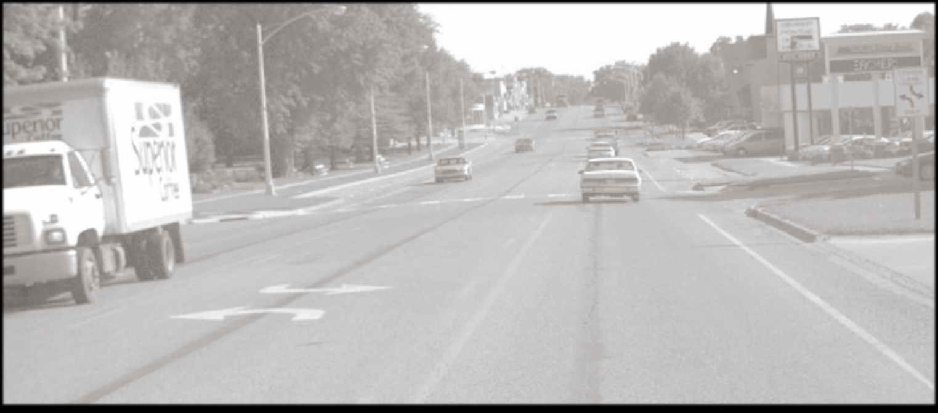
Statewide Lane Reconfiguration Screening
Samuel Sturtz
Transportation Planner
Iowa Department of Transportation
samuel.sturtz@iowadot.us
Photo Credit: Keith Knapp

Slide 2
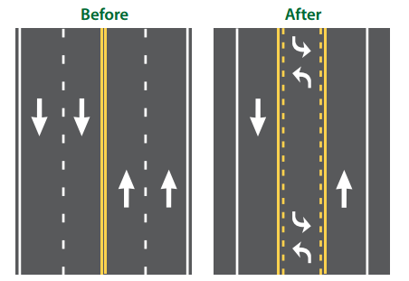
What is a Reconfiguration
Photo Credit: Paul LaFleur FHWA

Slide 3
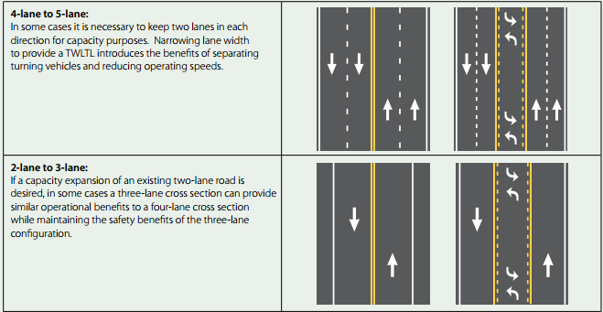
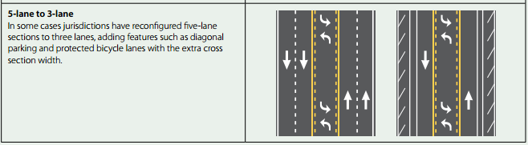
What do others look like?
Photo Credit: Paul LaFleur FHWA

Slide 4
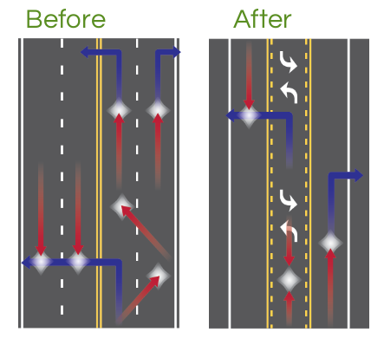
Why consider a reconfiguration?
Photo Credit: Paul LaFleur FHWA

Slide 5
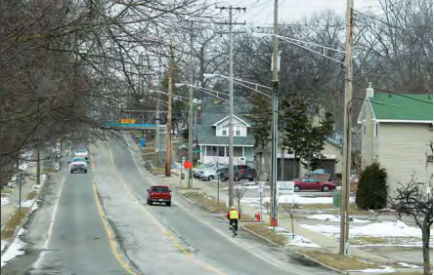
Statewide Screening for Lane Reconfiguration
Background of Project
  Peer exchange opportunity
  Current applications coming online
  Opportunities to implement
    Intuition
    Data driven
Photo Credit: Jennifer Atkinson and Paul LaFleur FHWA

Slide 6
Feasibility of Study
Factors for determining feasibility
  Roadway function and environment
  Overall traffic volume and level of service
  Turn volumes and patterns
  Frequent-stop and/or slow-moving vehicles
  Weaving, speed, and queues
  Crash types and patterns
  Pedestrian and bike activity
  Right-of-way availability, cost and acquisition impacts
  General characteristics: parallel roadways, offset minor street intersections, parking, corner radii, and at-grad railroad crossings

Slide 7

Limitations of Screening
  Data
    Only as good as what is available
  Scope
    Entire state limits granularity of analysis
  Time
Notes:
When talking about scope make sure to say that although it’s a high level of analysis it is effective on identifying candidates

Slide 8

Analysis Structure
Data Elements
  Network screening elements
    Roadway data elements
      Number of lanes
      Median type
      AADT
      Major and minor intersections
      Business and private entrances
    Additional data elements
      Signalized intersections
      Segment level crash data

Slide 9
Phasing of Analysis
First Phase: Querying of Data
  High level screening
    All segments including
      4 lanes
      No median
      Two way
    Varying lengths included
    AADT
      Further restricted=<18,000
Notes:
Make sure that when I mention filtering I am not actually taking candidates out by this process. More ore less flagging them or identifying aspects of them.

Slide 10
Phasing of Analysis
Second Phase: Filtering and Calculations
  Geoprocessing and filtering
    Intersection Analysis
      Intersection database
        Buffer analysis to determine high concentrations of signalized intersections
    Access Density
      Calculated field within ArcGIS
      Per mile basis

Slide 11
Phasing of Analysis
Third Phase: Geoprocessing and Aggregation
  Site Aggregation
    Dissolving feature within ArcGIS
      Focused on sites .5 miles or longer
      Manual Aggregation
        Disconnected but continuous sites
    Crash Data
      Segment level crash data
        Select by identified locations
        Aggregate up to corridor potential candidates
5
5
5
5
20

Slide 12
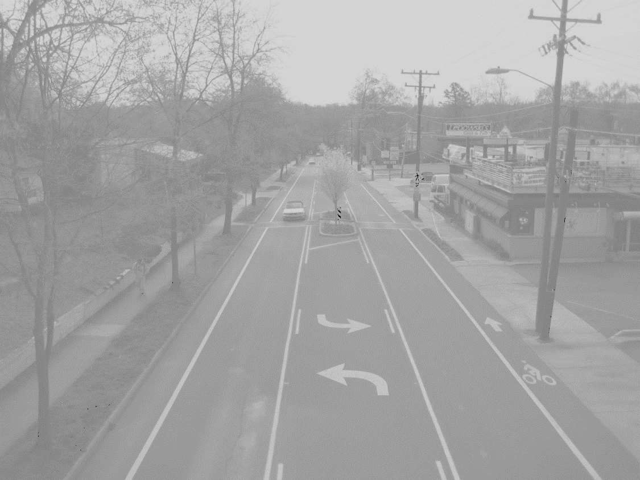

Phasing of Analysis
Fourth Phase: Identification of Existing Three-Lane Configurations
  Secondary Screening
    Change of query to identify three-lane configurations-(TWLTL)
    Repeated Phases 1-3
    Initial identification was supplemented by two sources
      Internal spreadsheet of known locations
      “Iowa’s Experience with Road Diet Measures: Use of Bayesian Approach to Assess Impacts on Crash Frequencies and Crash Rates”-Michael Pawlovich
Photo Credit: Charlotte, NC. NCDOT & Paul LaFleur FHWA

Slide 13

Phasing of Analysis
Fifth Phase: Quality Control
  Nothing is perfect
    Data
    Visual inspection of each potential candidate and existing three-lane sites
      Aerial and street view photos
      This phase resulted in re-aggregation of some selected sites.

Slide 14
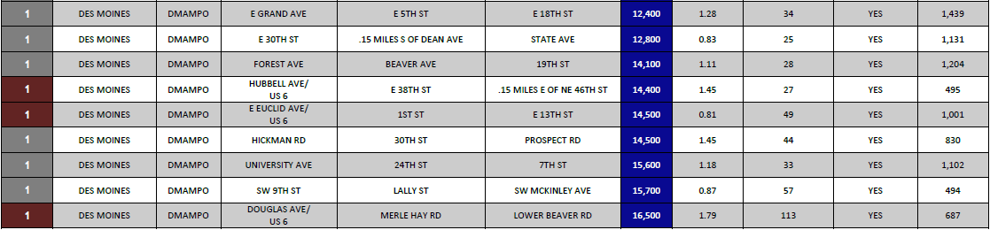
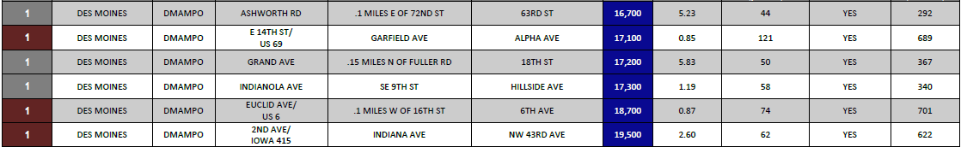
Candidate Locations in Des Moines Metro

Slide 16
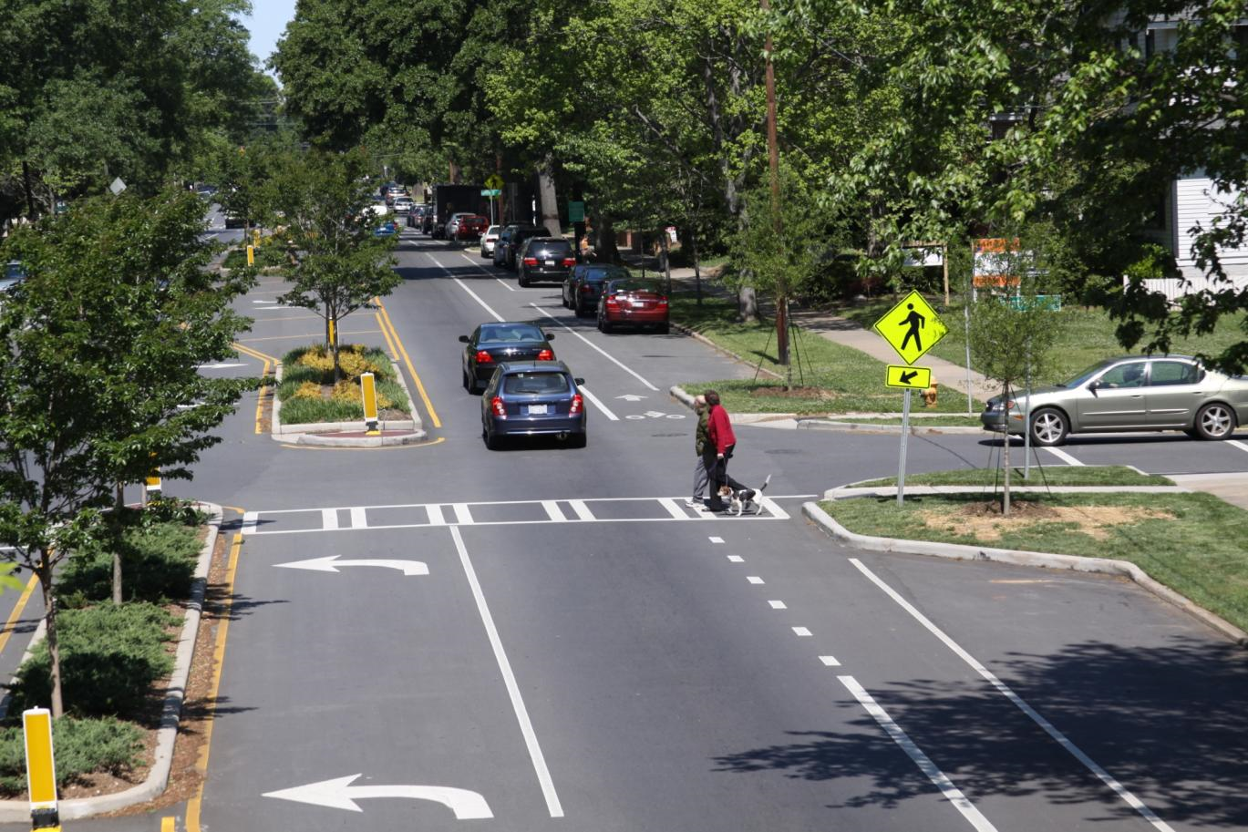
Samuel Sturtz
Transportation Planner
Iowa Department of Transportation
samuel.sturtz@dot.iowa.gov
Photo Credit: Charlotte, NC. NCDOT & Paul LaFleur FHWA

