Slide 1
Bicycle and pedestrian roundtable
New Resources
October 16, 2018

Slide 2
Resources
https://peopleforbikes.org/wp-content/uploads/2018/09/PFB-010-Presentation-FINAL.pdf
https://altaplanning.com/wp-content/uploads/Behavioural-Insights-to-Transportation-Demand-Management_FINAL.pdf
https://www.sfmta.com/sites/default/files/reports-and-documents/2018/03/safestreetsevaluationhandbook_dec2017.pdf
https://www.cdc.gov/physicalactivity/activepeoplehealthynation/index.html

Slide 3
From Asphalt to Aspiration
People for Bikes
Market research and message development
ID values and motivations around bicycle infrastructure and mobility options

Slide 12
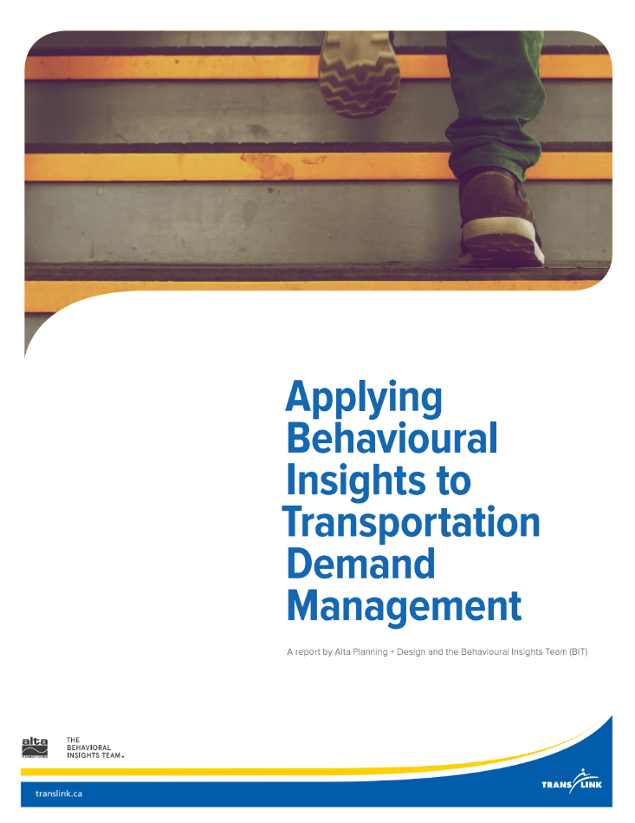
Behavioural Research
Alta Planning Report
Research-driven, tested methods for TDM
Consult if working on incentive programs, mode-shift initiatives, or smart cities strategies

Slide 13
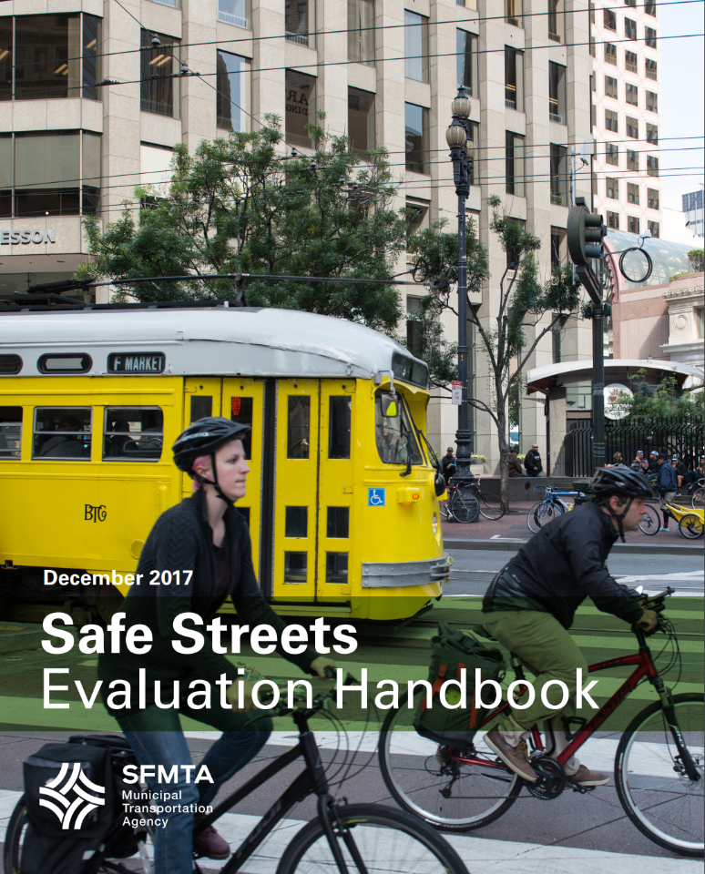
Safe Streets Evaluation Handbook
SFMTA Handbook
How-to for developing an evaluation plan including process, performance metrics, and data collection

Slide 14
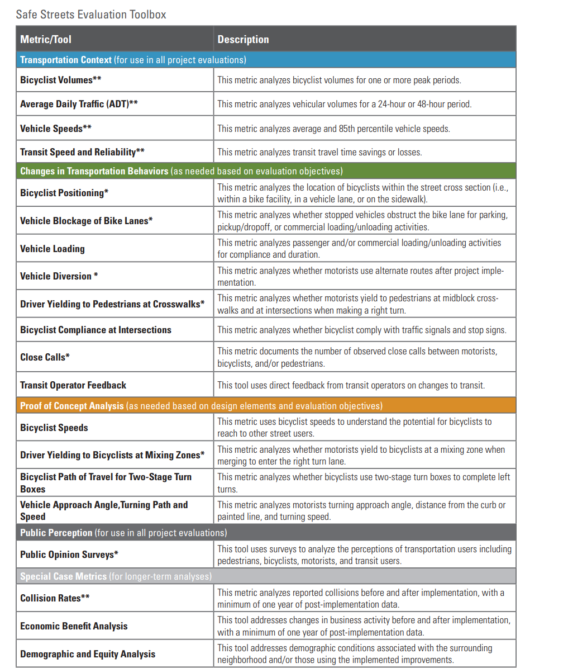
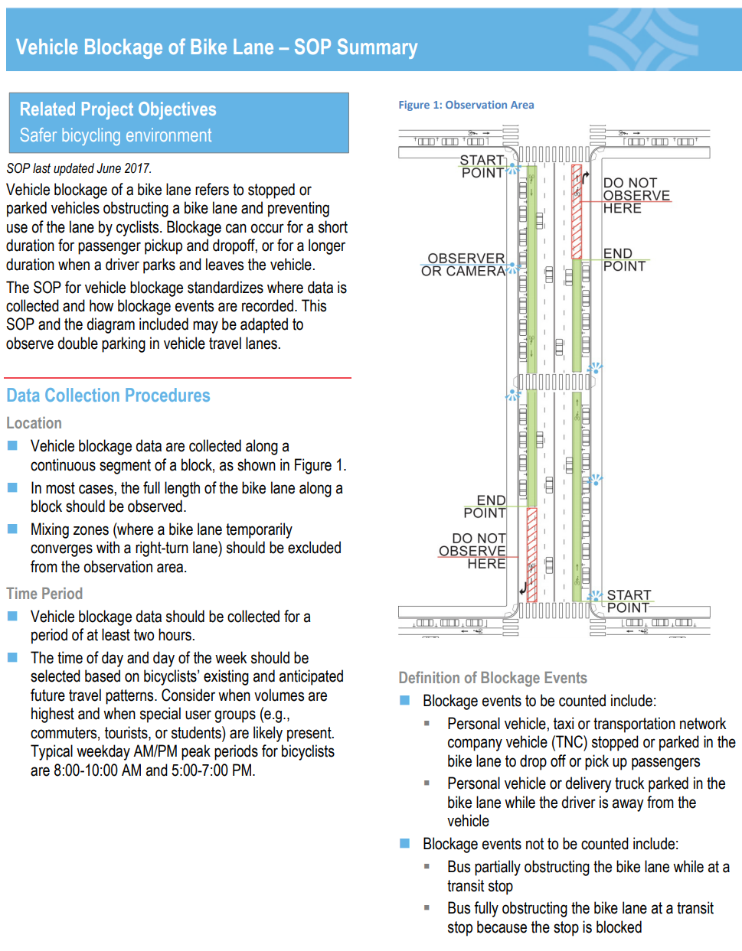

Slide 15
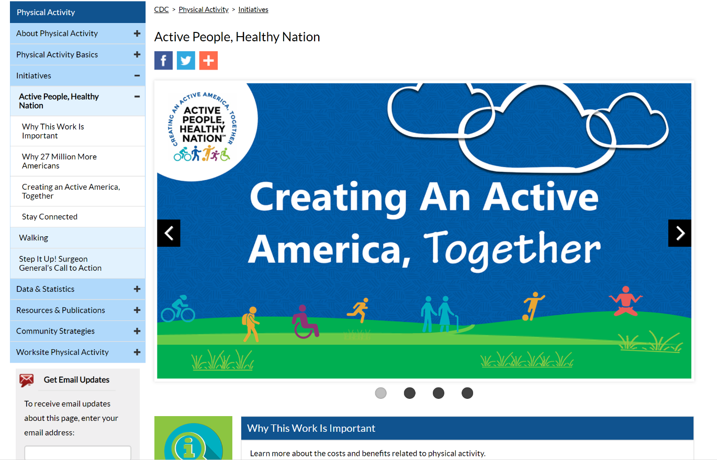
Active People, Health Nation
CDC Webpage
Collection of evidence-based strategies, data, statistics, and resources for active transportation

