Slide 1
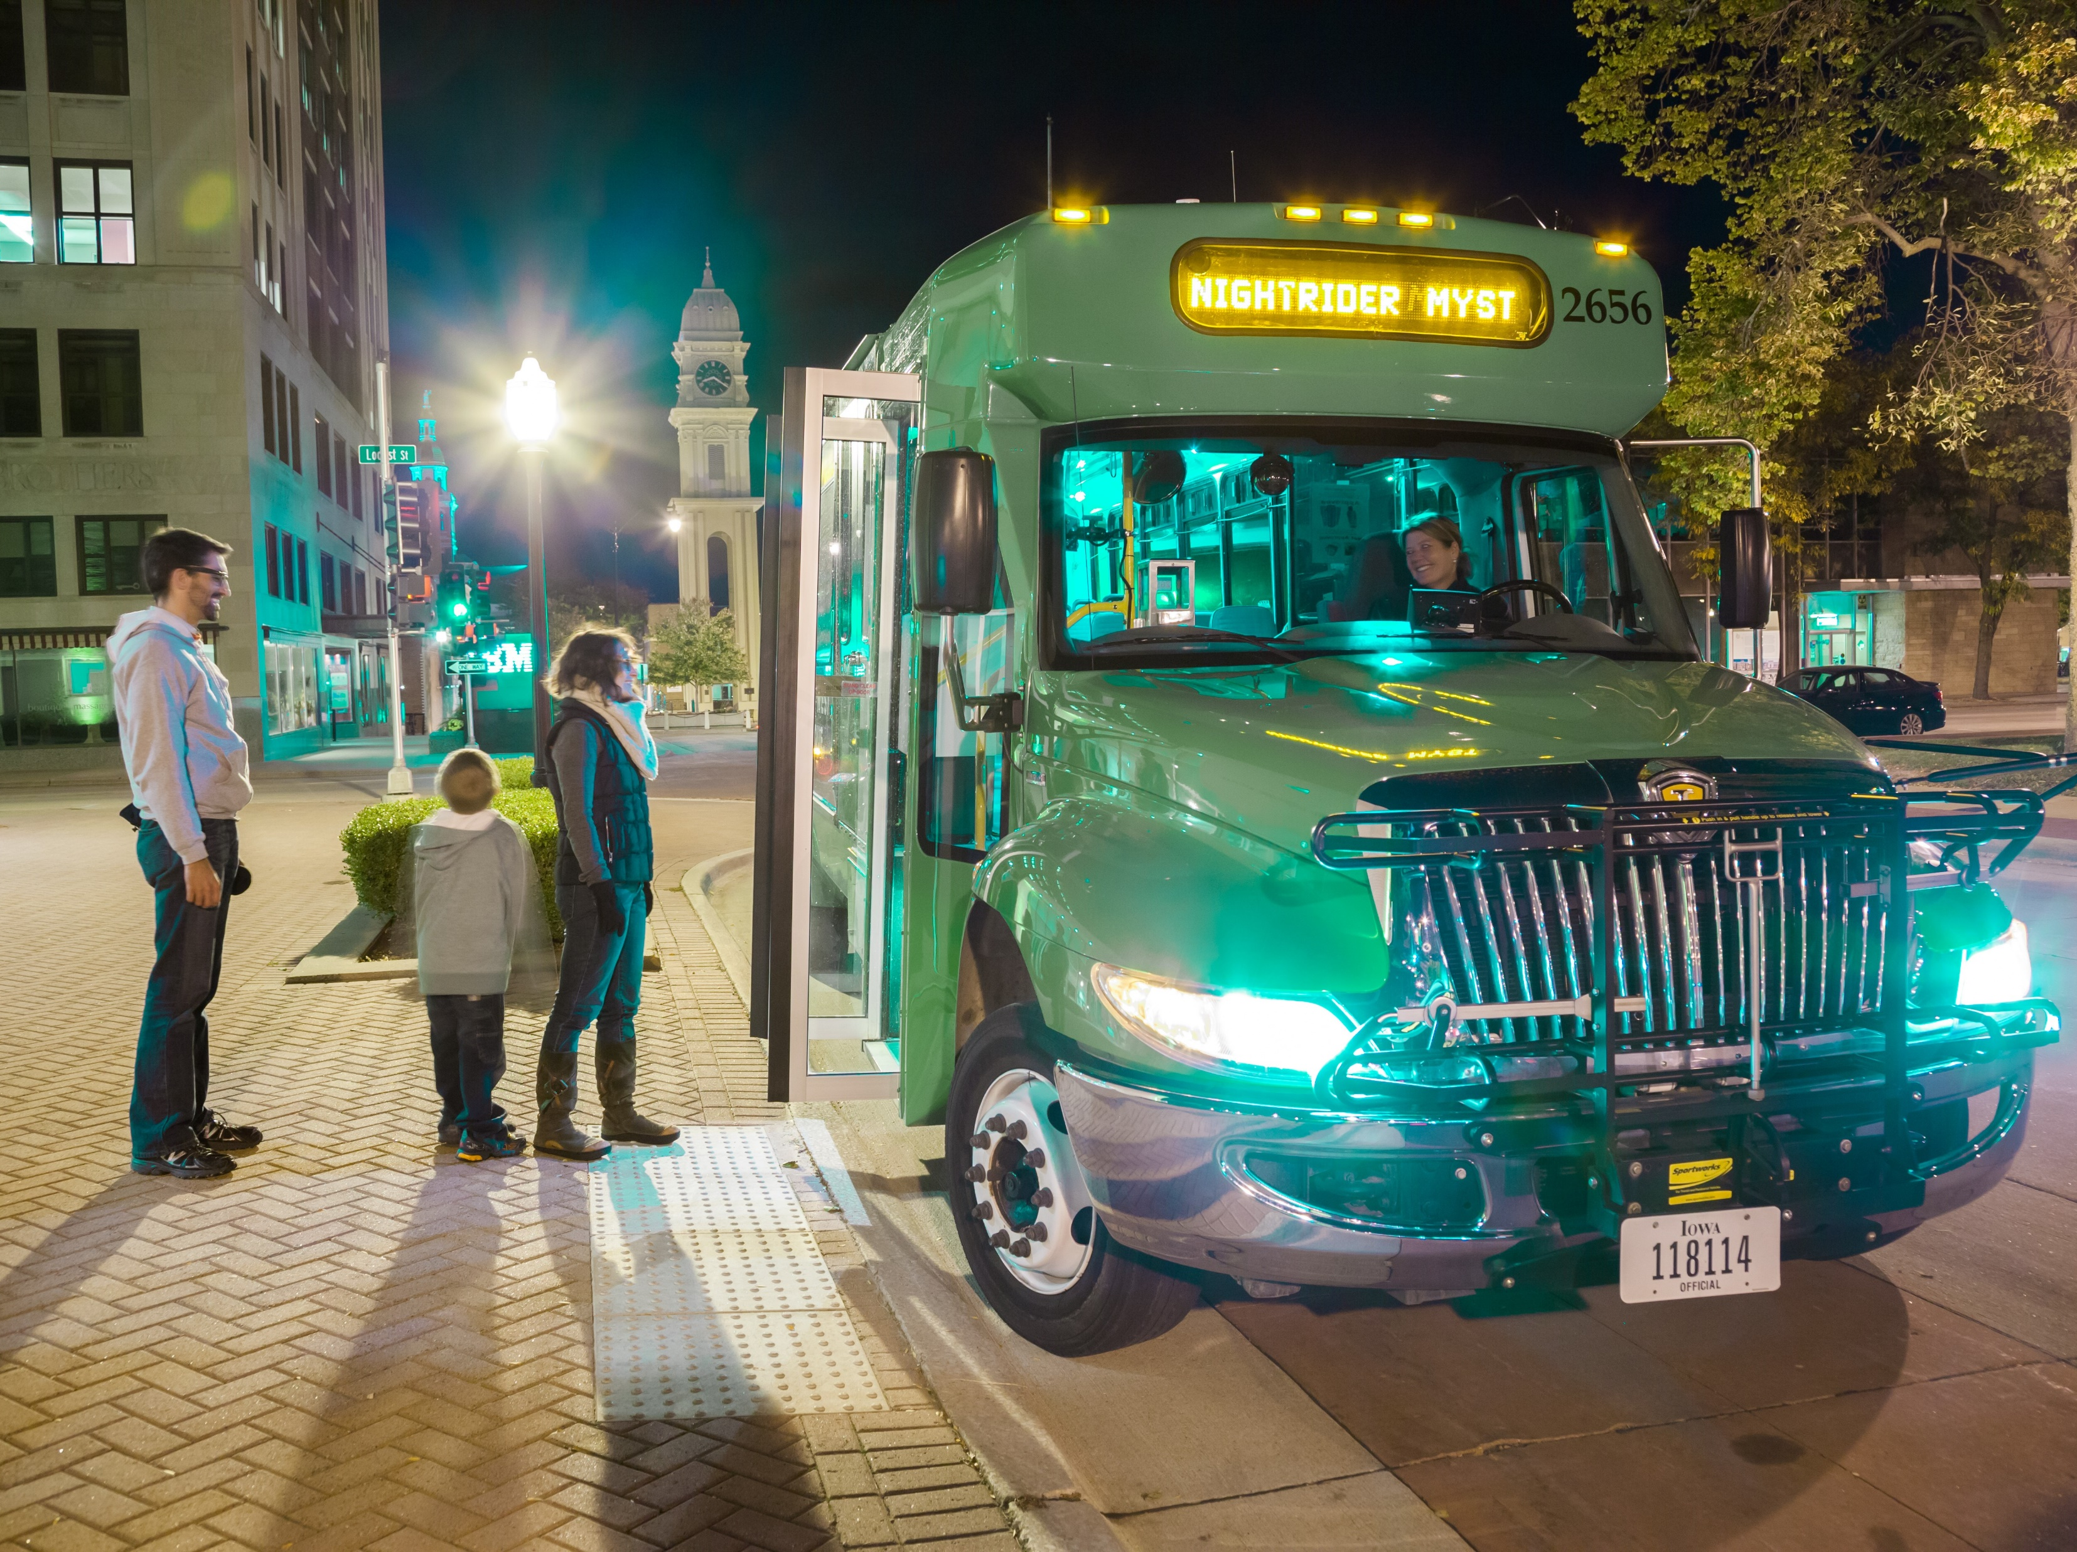
JOE DRAHOS
SYSTEMS PLANNING BUREAU | PASSENGER PLANNING
PLANNING, PROGRAMMING & MODAL DIVISION
Iowa Department of Transportation
800 Lincoln Way, Ames, IA 50010
Office: 515.239.1772 Email: joseph.drahos@iowadot.us
Public Transit Plan progress report
OpportUNITY | Transportation Work Group Meeting
Des Moines Area MPO
November 20, 2019

Slide 2
Progress Report
Iowa Public Transit Long Range Plan
2019
2020
March
October
Spring
Analyze Data
Survey Results
Ridership Dependency
Funding and Cost Trends
Brainstorm Ideas
IPTA Legislative Conference
Passenger Transportation Summit
2018
December
2020
June
Identify Issues
Transit Needs Survey
Service
Fleet
Facility
Personnel
Technology
Get Feedback
Stakeholder Meeting
Transit Plan Website
Public Survey
Develop Content
Draft chapters
Introduction
Iowa’s Transit Context
Needs and Strategies
Financing
Implementation and Evaluation
May
November
Notes:
This is just a summary slide highlighting the key points that are explained in greater detail in the next few slides.
Points:
Effort began in December 2018
Major muscle movements include the identification of transit-related issues in the spring with the needs survey.
This led to the presentation of the survey results and initial generation of ideas at the IPTA legislative conference in April and Passenger Transportation Summit in May
After refining the ideas, we crafted a draft vision statement, goal areas and strategies that were vetted by the stakeholder meeting in September
September through October was focused on soliciting feedback on those strategies through the public survey
The remainder of the fall is/was focused on analyzing survey results, conducting the ridership dependency analysis, and examining funding/cost trends; historically and projected
The planning effort concludes with content development focused on the winter/spring and publication in June of 2020

Slide 3
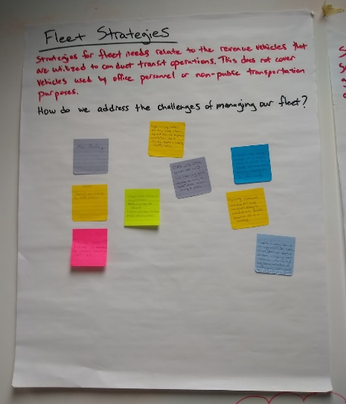
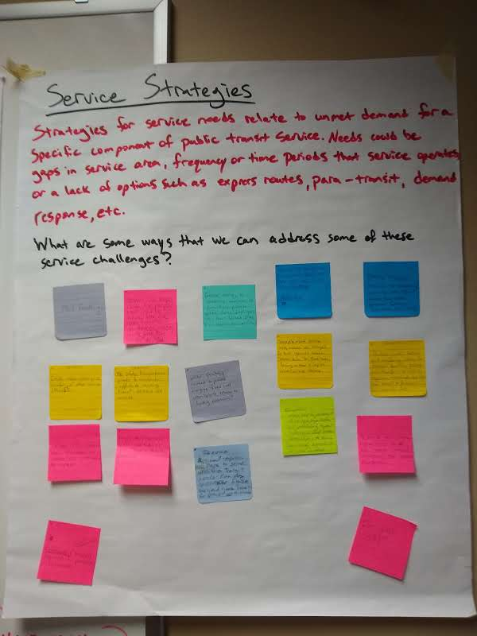
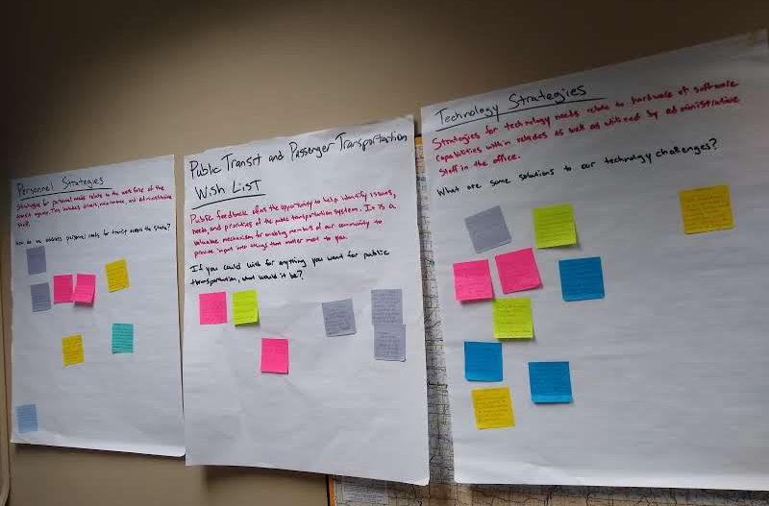
Progress Report
Iowa Public Transit Long Range Plan
Iowa Transit Needs Survey
(March) 100% of transit agencies responded
Brainstorm Exercise
(April) IPTA Legislative Conference
(May) Passenger Transportation Summit
Stakeholders
(September) External Stakeholder Meeting #1 discussed the public survey, vision statement, goals, strategies. Will meet monthly (alternating between in-person, teleconference)
Public Survey
(October) More than 560 responses
External Stakeholder Membership
Cedar Rapids Transit
Marshalltown Transit
Southwest Iowa Transit Agency (SWITA)
American Association of Retired Persons (AARP)
American Cancer Society
University Centers for Excellence in Developmental Disabilities (UCEDD)
Veteran’s Affairs
Iowa State University – Extension & Outreach
Iowa Department of Public Health
Notes:
These next few slides expounds on the summary points mentioned in the timeline slide.
Points:
Iowa Transit Needs Survey
100% response rate from all transit agencies in the state
Asked a variety of needs-based questions on service, fleet, facility, personnel, and technology issues
Asked the agencies to try to forecast those needs out to our short-term planning horizon of 2030 and long-term horizon of 2050
Results were shared at the IPTA Legislative Conference and Passenger Transportation Summit
Results: https://iowadot.gov/iowainmotion/files/March_2019_Iowa_Transit_Needs_Survey_results.pdf
Brainstorm Exercise
Tested at IPTA then fully unveiled at Passenger Transportation Summit
Several large sticky boards with each of the needs-categories (from the needs survey)
Participants included federal/state/local government, non-profit organizations, transit agencies, and members of the public
Received about 60 individual pieces of feedback
Used to generate initial draft vision statement, goal areas, and strategies
Stakeholders
First meeting in mid-September to discuss the draft vision, goals, and strategies
Major output was providing guidance on the public survey
Plan to hold these meetings likely every other month, mixing in-person with teleconference
Public Survey
Opened October 18th and “officially” ended November 1st
Survey is still technically active and we are still receiving hardcopy submissions of the survey
The survey was primarily in Survey Monkey but offered as .pdf in English and Spanish. Attempts were made to ensure screen readers for visually impaired users could access it.
Currently, we have around 580 responses
Still, analyzing the results, but it was nearly 50-50 as far as non-transit users vs. transit users.

Slide 4
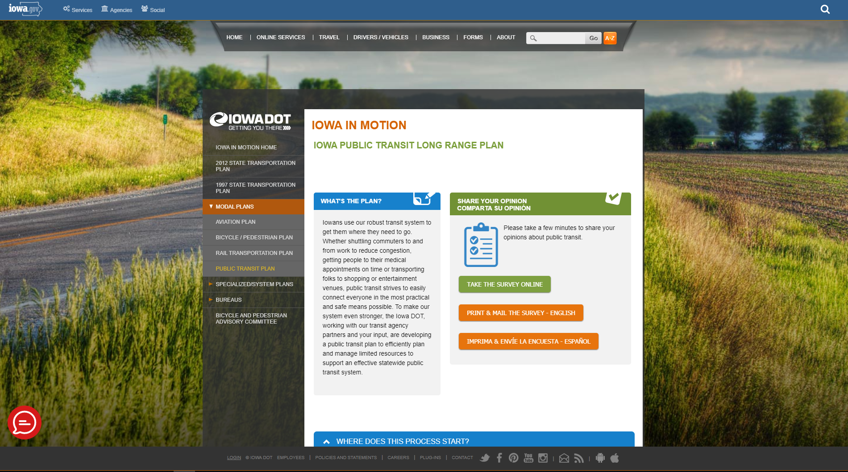
Progress Report
Iowa Public Transit Long Range Plan
Website
(October) Host information on the planning effort. Launch point for the public survey.
https://iowadot.gov/iowainmotion/Modal-Plans/Public-Transit-Plan
Notes:
Points:
Website
Along with the public survey, we opened a web page dedicated to this planning effort.
Press releases have all directed users here, where they can follow the buttons for the surveys
Serves as single-source for all transit plan related updates and content
This is where the final plan will reside along with, hopefully, an interactive version of the plan and the data/analysis/results
Site: https://iowadot.gov/iowainmotion/Modal-Plans/Public-Transit-Plan

Slide 5
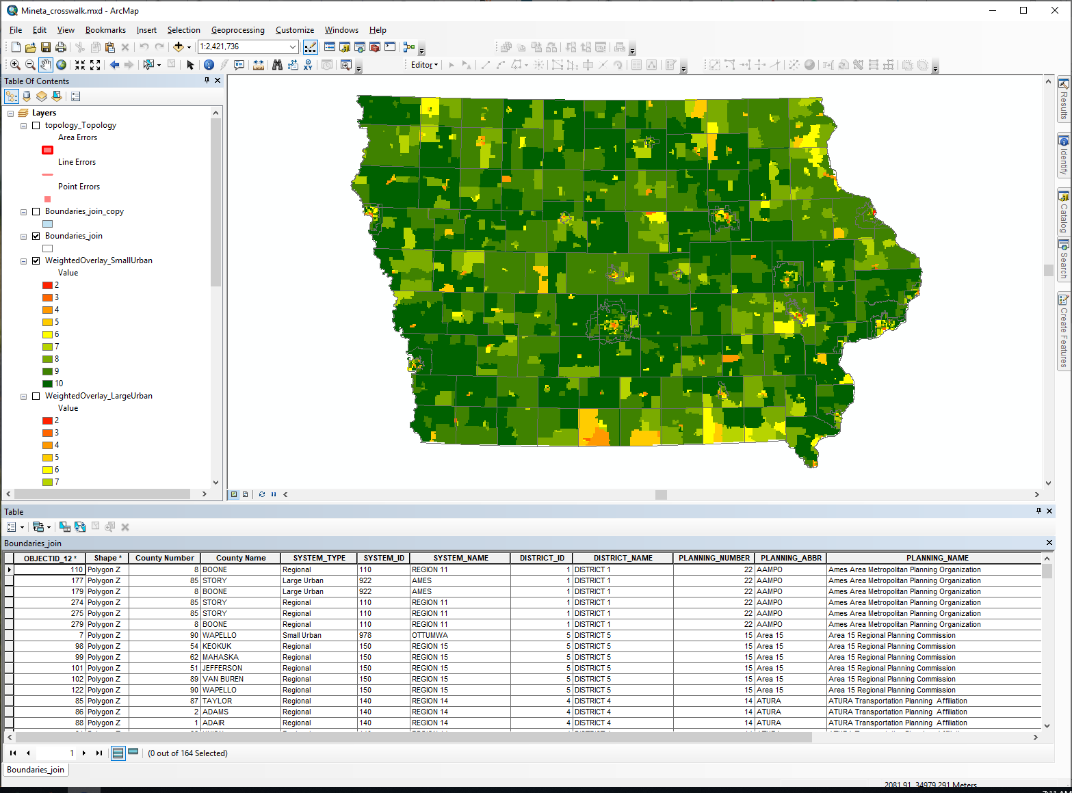
Progress Report
Iowa Public Transit Long Range Plan
Analysis
(October) Consolidated analysis weighting feedback from Transit Agencies. 15 total responses; same ratio of large : small : regional.
(November) Conclude analysis of ridership factors based on a study by the Mineta Transportation Institute.
Cost & Revenue
(November) Conclude analysis of historic and forecasted expenses and revenue in order to determine shortfalls. Using feedback from survey in March to help forecast personnel, facility, vehicle needs out to 2050.
Notes:
Points:
Transit ridership dependency analysis
Based on study conducted by Mineta Transportation Institute at San José State University: https://transweb.sjsu.edu/research/investigating-determining-factors-transit-travel-demand-bus-mode-us-metropolitan
Utilized and refined several of the external factors that impact ridership
Weighting for the individual factors was determined through a poll of the transit agencies
Gas Prices, Median Household Income, Carless Households, Language, Race, Enrolled in College, Population Density
Planning on overlaying GTFS bus routes/stops on the “heat map” overlays in order to determine gaps in coverage
Cost & Revenue analysis
Using a combination of reported data through the DOT’s Transit Portal, US Bureau of Labor Statistics data on inflation/average wages, and facility cost data from the Transportation Research Board (TRB): https://apps.trb.org/cmsfeed/TRBNetProjectDisplay.asp?ProjectID=3622
The Transit Needs Survey from last March is helping with additional personnel, vehicle, and facility needs by 2030 and 2050
After combining historical and forecasted expenses subtracted from anticipated revenue, we will determine the shortfalls, then evaluate the possibility of leveraging some of our revenue generating mechanisms that were drafted earlier.

Slide 6
Progress Report
Iowa Public Transit Long Range Plan
Stakeholders
(November) External Stakeholder Meeting #2 to discuss the public survey results, ridership dependency factor analysis, funding analysis. Will meet remotely via teleconference.
(November) Internal Stakeholder Meeting #1 with select Iowa DOT staff.
Content
(Winter/Spring) Develop and finish content for the plan and complete most of the first half by winter, second half by spring.
Completion
(June) Approval of final draft and publication.
External Stakeholder Membership
Cedar Rapids Transit
Marshalltown Transit
Southwest Iowa Transit Agency (SWITA)
American Association of Retired Persons (AARP)
American Cancer Society
University Centers for Excellence in Developmental Disabilities (UCEDD)
Veteran’s Affairs
Iowa State University – Extension & Outreach
Iowa Department of Public Health
Internal Stakeholder Membership
Aviation
Rail Transportation
Location & Environment
Driver & Identification Services
District Planner
Notes:
Points:
Held the 2nd External Stakeholder Meeting last Monday 11/18 via Skype call
Shared updates on the analysis and the public survey
Projected late January/early February for the next meeting to review content
Will hold the 1st Internal Stakeholder Meeting next Monday 11/25 in-person

Slide 7
Survey Results – Demographics
Iowa Public Transit Long Range Plan
2019 Public Transit Survey
2016 Long Range Plan Survey
Notes:
Comparing our public survey question to the same question that was asked when we were updating the Long Range Plan in 2016.
The extremes are the only ones that are increasing and consistent between both surveys (rural areas and core or downtown metro areas.
Differences:
2019 Transit Plan survey shows static suburbs while large and small standalone cities as decreasing
2016 Long Range Plan survey shows static large cities, decreasing small cities, and greatly decreasing suburbs

Slide 8
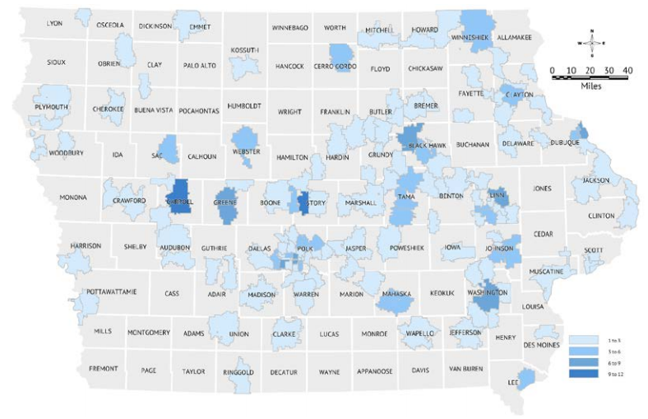
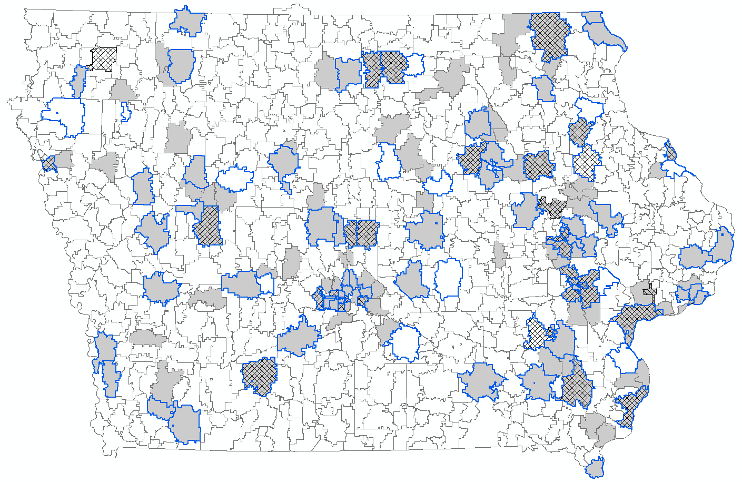
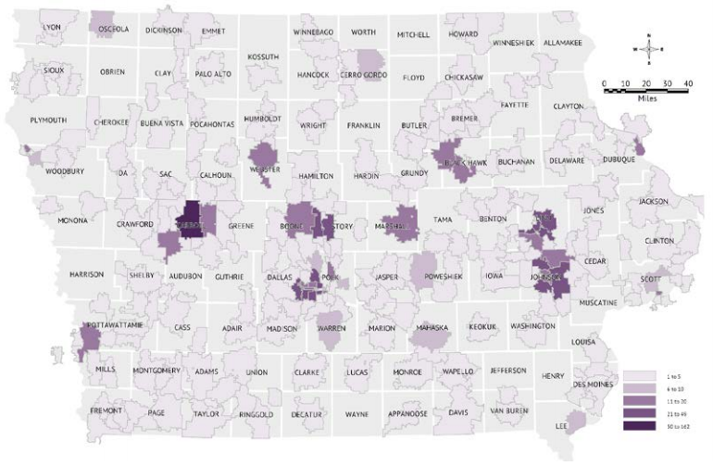
Survey Results – Distribution
Iowa Public Transit Long Range Plan
2019 Public Transit Survey
2016 Long Range Plan Surveys
Work
School
Home
Notes:
Comparing our public survey ZIP Code distribution to the Long Range Plan in 2016.
Results are generally consist between planning efforts, as far as which ZIP Codes respond or provide feedback
The 2016 Long Range Plan surveys had more representation from Jefferson, Monticello, and Tama areas though.

Slide 9
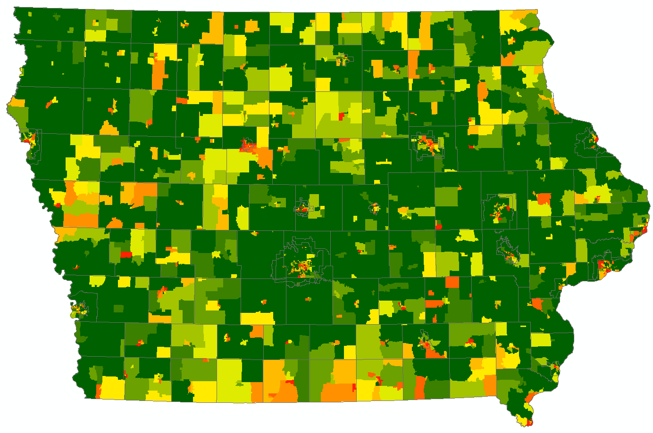
GIS Results – Median Household Income
Iowa Public Transit Long Range Plan
Notes:
Typical example of our overlays from the Transit Ridership Dependency analysis
Reddish areas show regions that are classified as “more transit dependent” while green areas are “less transit dependent”
The classification of the regions is based on the statewide average for that specific factor. Any block group areas that are “better” than the statewide average are assigned a value of 10 while the remaining areas are divided into the other 9 classifications.

Slide 10
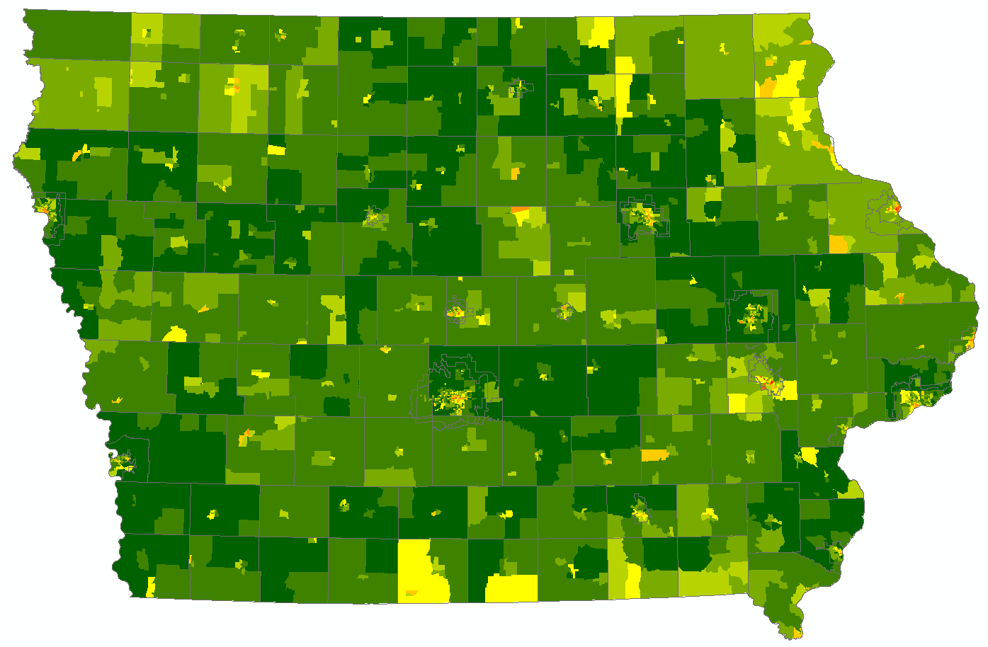
GIS Results – Weighted Regional (All) Average
Iowa Public Transit Long Range Plan
Notes:
This is one example of a weighted overlay using the feedback from the transit agencies.
Each of the 7 external factors had a unique weight placed on it (usually between 5 and 50) to indicate how relatively important that factor was for predicting transit dependence
The goal is to use such a map with service routes overlaid on top in order to identify gaps in the system. Yellow-orange-red areas that are lacking service will be the areas that should get attention.
The overlay can also be used to determine “why” a particular area is predicted to be transit dependent. I.E. an area with red areas for language could represent concentrations of immigrant populations that may also be carless. Unique strategies can then be targeted in that area related to those factors. Those same strategies likely will not work in other areas that are transit dependent but may exhibit a combination of high gas prices and low median household income or high numbers of carless households.

Slide 11
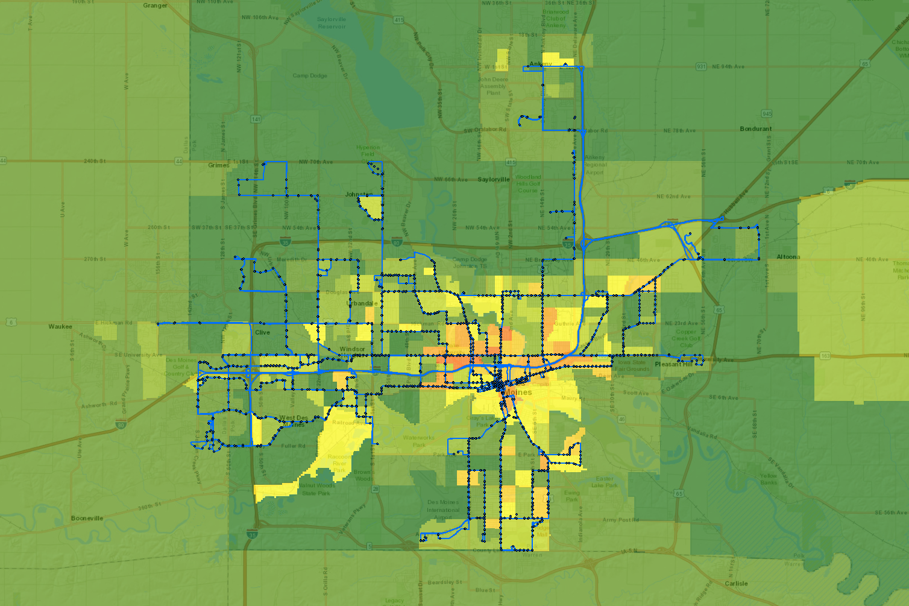
GIS Results – Weighted Regional (All) Average
Iowa Public Transit Long Range Plan
Notes:
Des Moines area with GTFS stops and routes overlaid on top of the Weighted Regional (All) Average

Slide 12
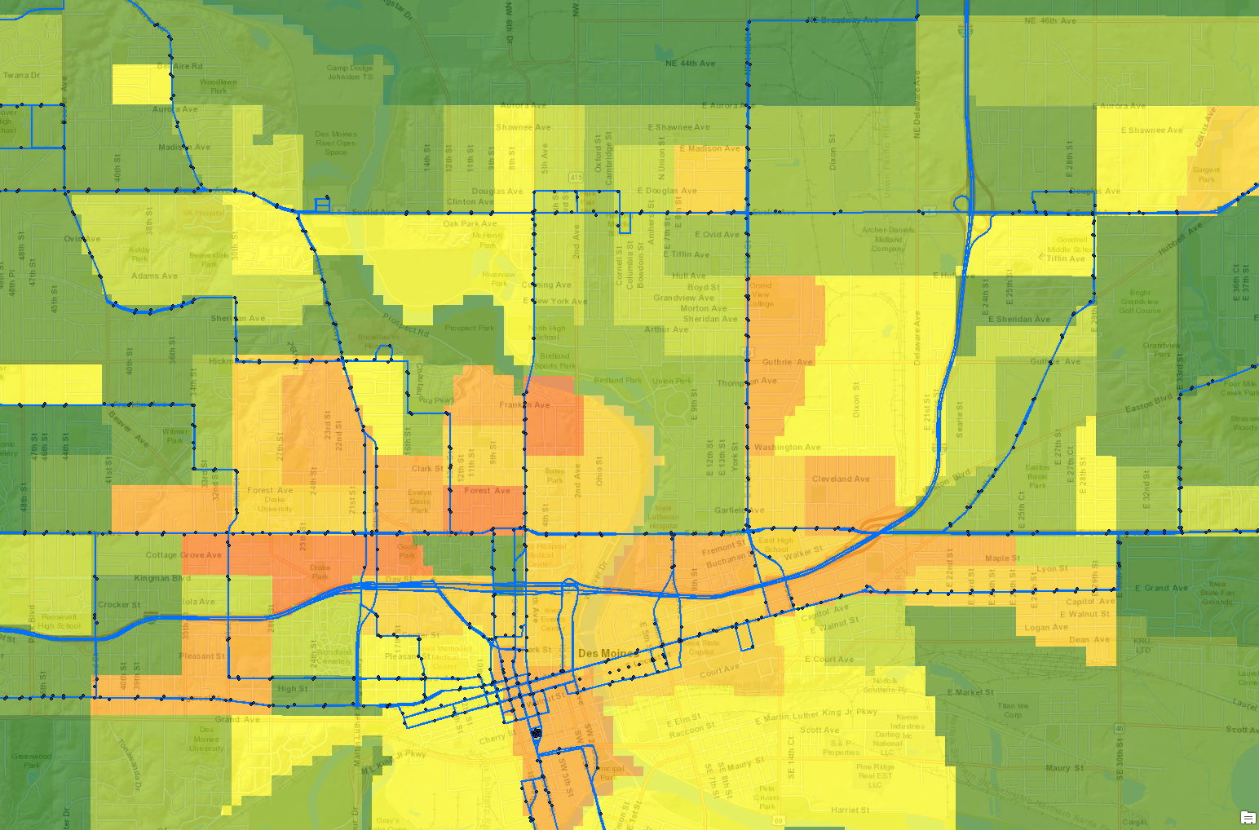
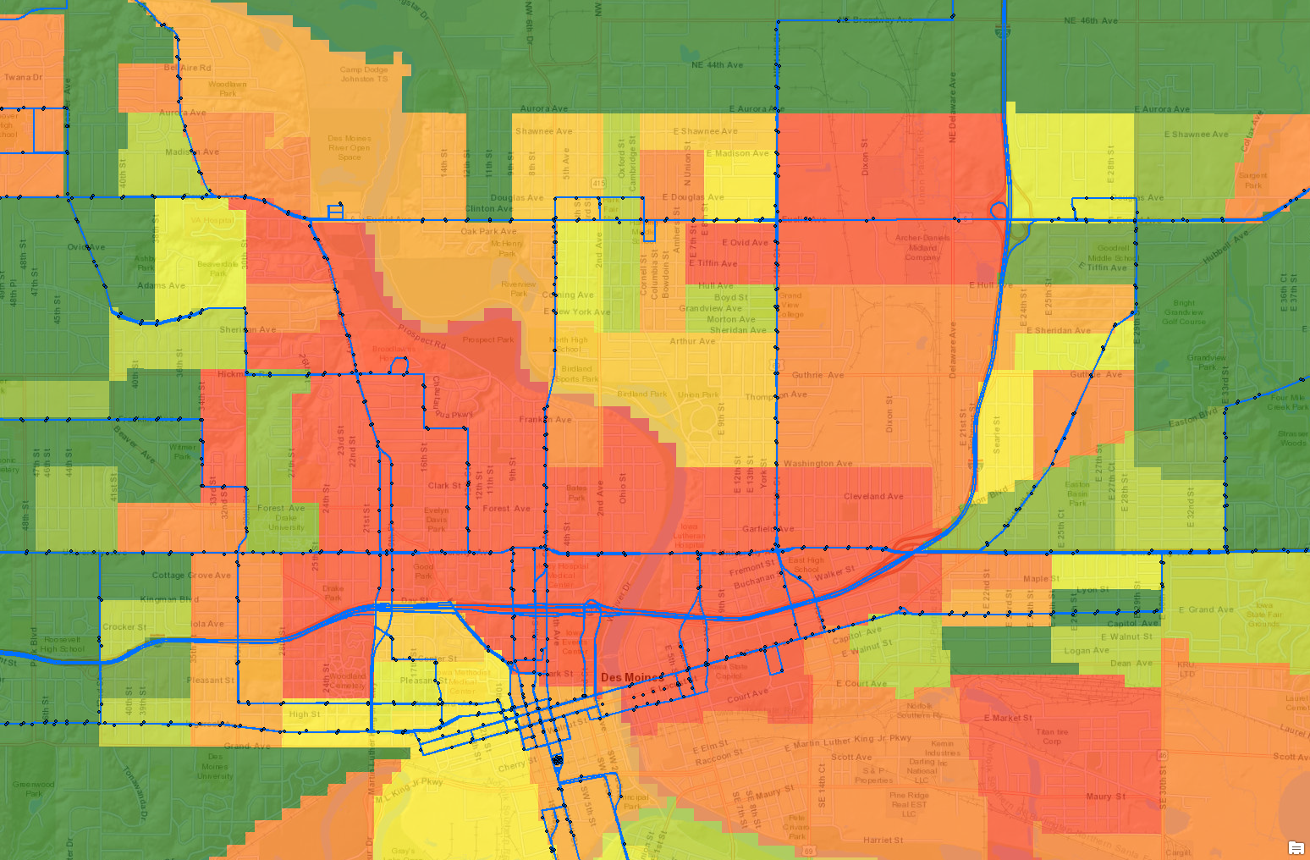
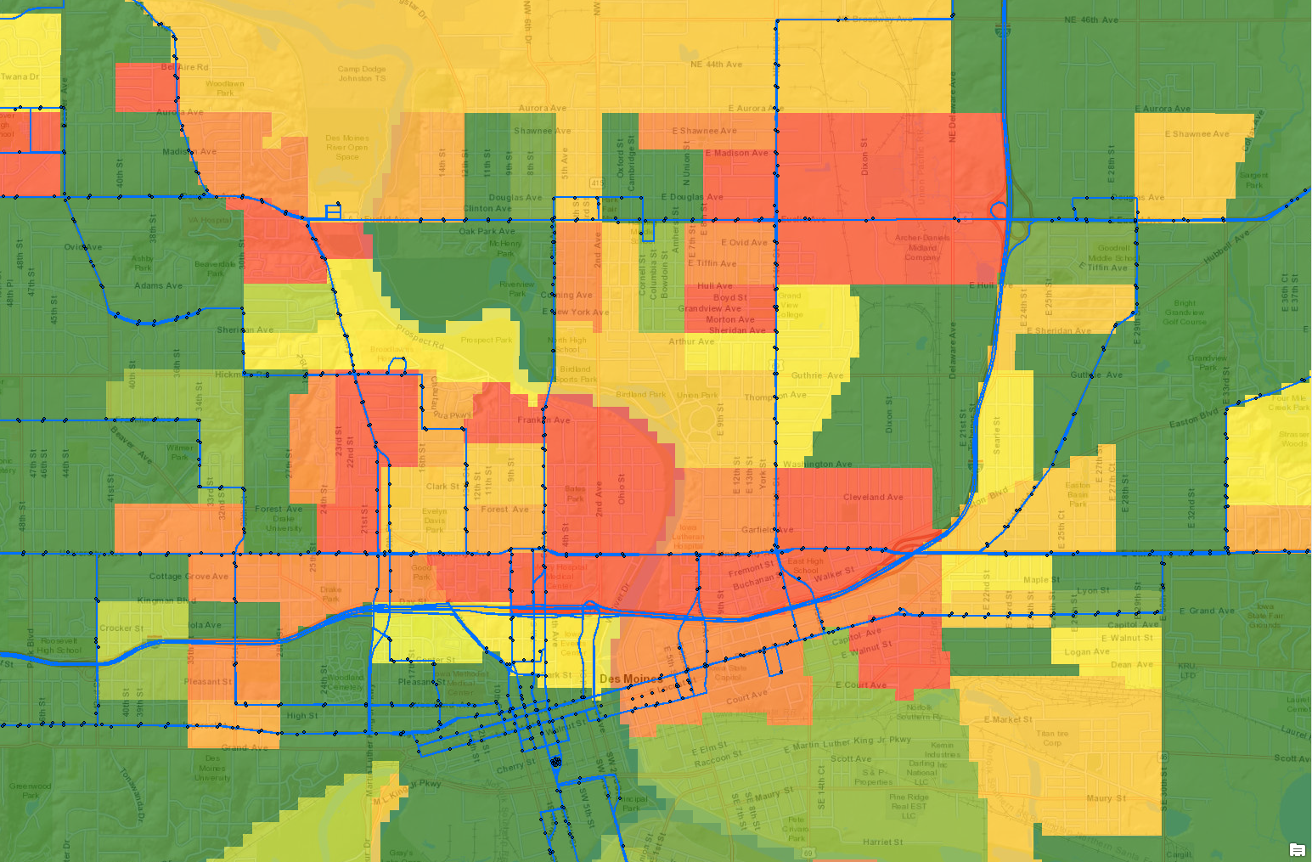
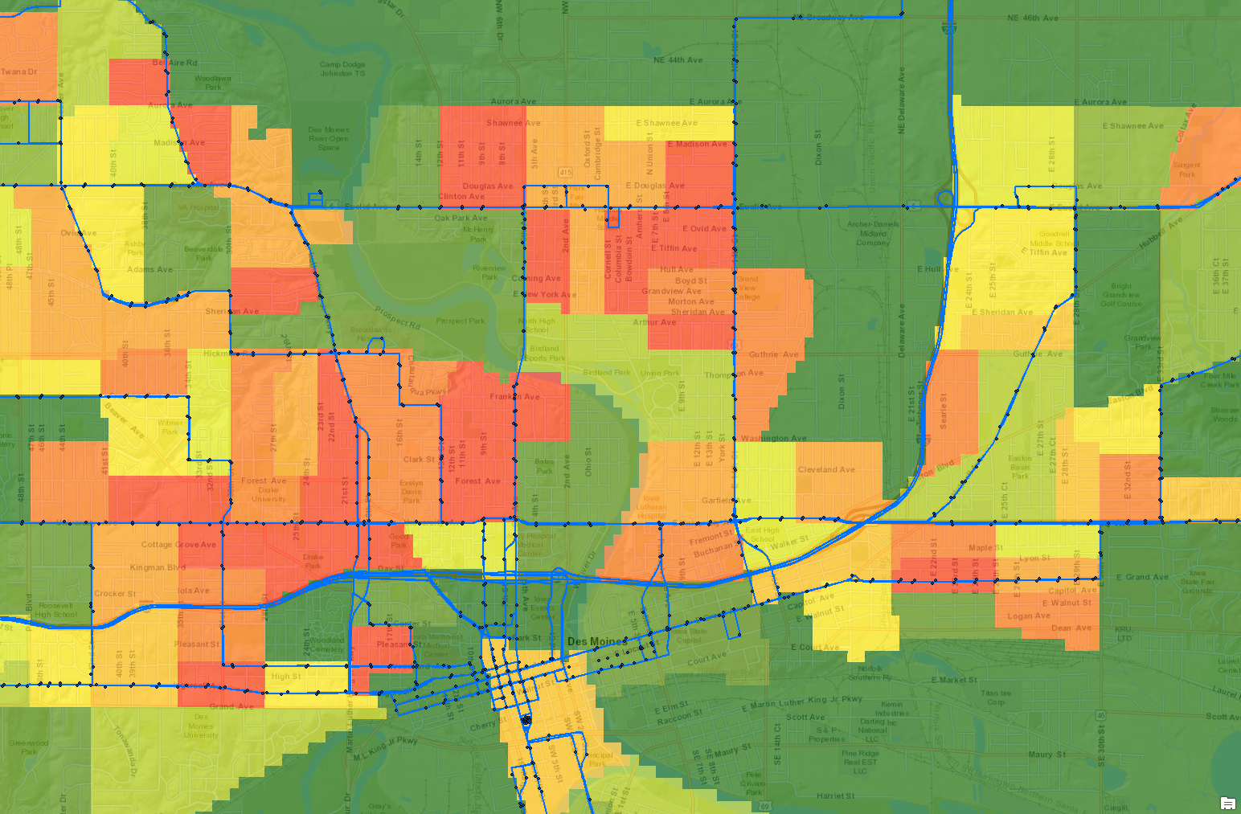
GIS Results – Weighted Regional (All) Average
Iowa Public Transit Long Range Plan
Non-Weighted Factors
Race
Language
Population Density
Notes:
Des Moines area with GTFS stops and routes overlaid on top of the Weighted Regional (All) Average
Zoomed-in to downtown Des Moines
Highlighted a few specific, individual non-weighted external factors i.e. Race, Language, Population, Density
To show how the same areas differ based on those criteria
The overall weighted results sometimes don’t tell the whole story about what those neighborhoods look like
These specific factors could be considerations to focus certain strategies

