Slide 2
Notes:
These fit into a larger picture, fit into a legitimate transportation system

Slide 4
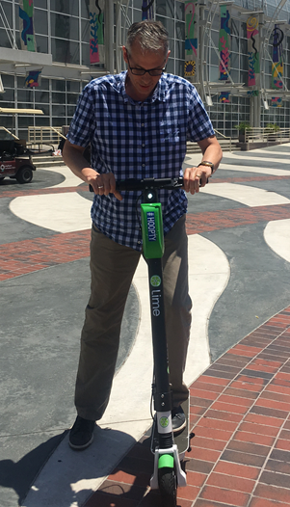
WHY E-SCOOTERS?
WHY NOW?
Talent and visitor attraction
Fosters multimodal transportation
Serves as first-mile/last-mile connector
E-scooters are already here
Vendors are asking
Seasonality
Notes:
Talent and visitor attraction:
Aligns with PlanDSM and Move DSM and other regional plans to create a multimodal transportation network
E-scooters are already here
--Vendors are asking --Test case, regionalism --Seasonaility --First-mile/last-mile (downtown)

Slide 5
VALUES
Safety
Choice
Strength
Cleanliness
Equity
Notes:
Omaha and Minn require the scooters to be collected each night and distributed each morning, and Kansas City and Indy have included involvement of the local transit agencies. Photos are of how e-scooters can be required to be locked (KC), or parked within a designated parking space (Indy transit station).
I also thought it would be good to reference that NABSA and NACTO have put out guidelines for the regulation of e-scooters and other micromobilty devices.

Slide 6
Process
Key Decision
Point
Determine Pilot Program
Fact Finding
Develop Recommendations
Operations
Collect info from potential e-scooter operators
Conduct outreach
Develop program criteria
Identify code changes needed
Define roles and resource needs
Make code changes
Issue Request for Proposals (RFP)
Issue Permits
Enforce permit regulations
Customer service
Collect data and evaluate

Slide 7
KEY STAKEHOLDER MEETINGS
Businesses
Neighborhood Associations
Public safety
Economic development
Public health advocates
AARP
Disability community advocates
Public meeting(s)

Slide 8
Feedback and Questions?

