Slide 1
Mobility On Demand Pilot
Des Moines Area MPO Environmental Roundtable
Luis Montoya, Planning and Development Manager
Tuesday, December 10 2019
Notes:
Good evening, thank you for your time tonight for us to share some updates from DART, especially as it relates to some major service changes the Commission is considering for fall 2019.

Slide 2
DART services

Slide 4
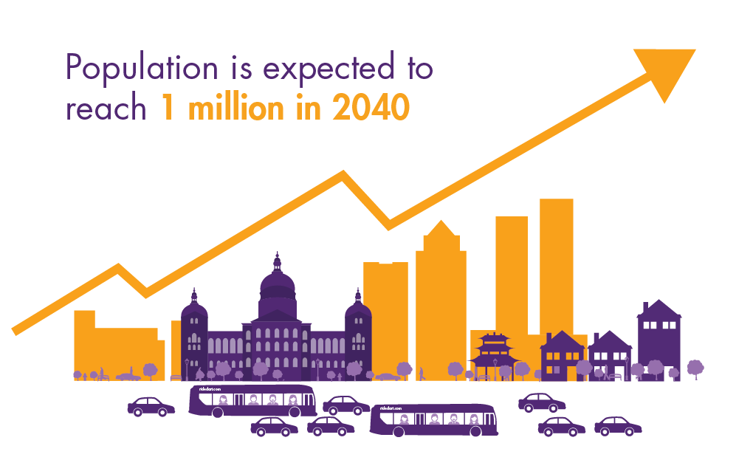
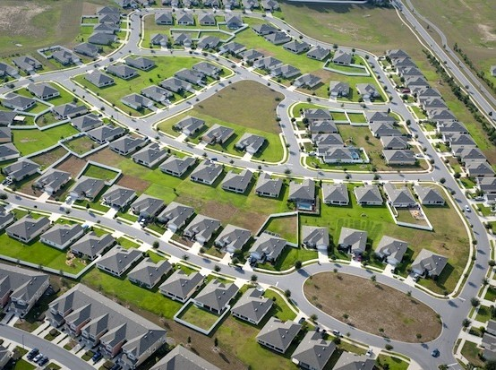
Challenges

Slide 5
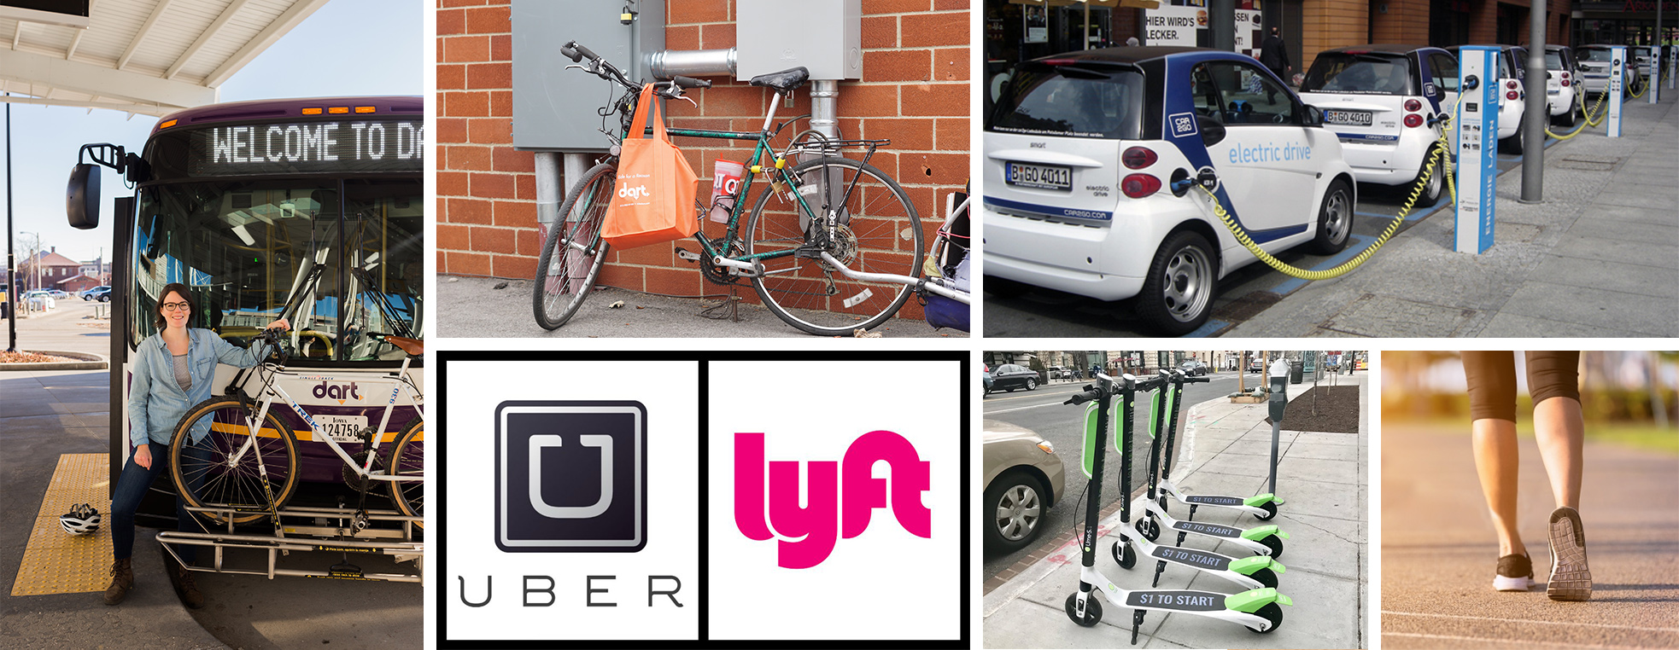
New mobility ecosystem
Photos of buses, bikes, walking, scooters, car sharing, uber/lyft

Slide 6
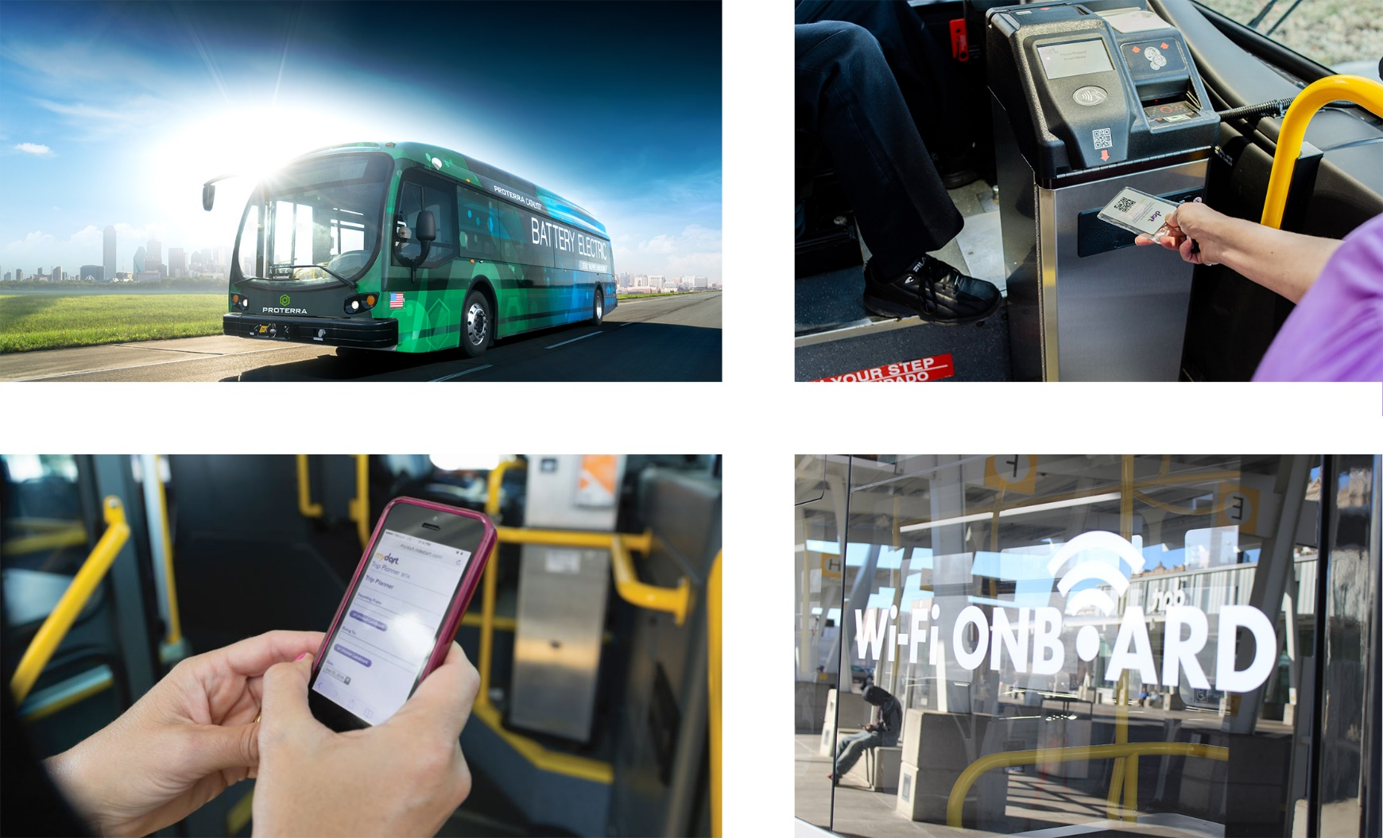
Transit Technology

Slide 7
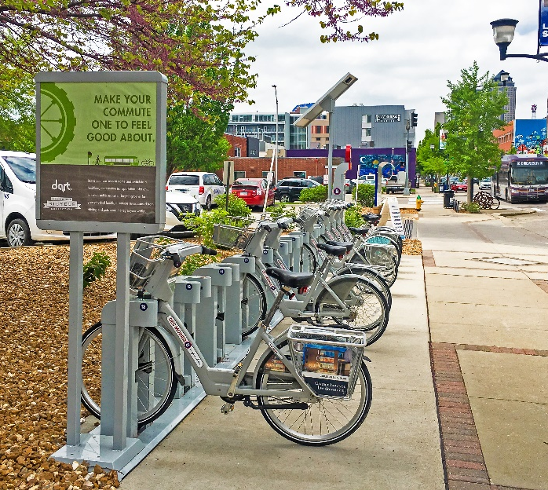
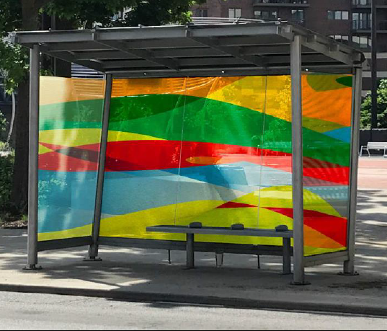
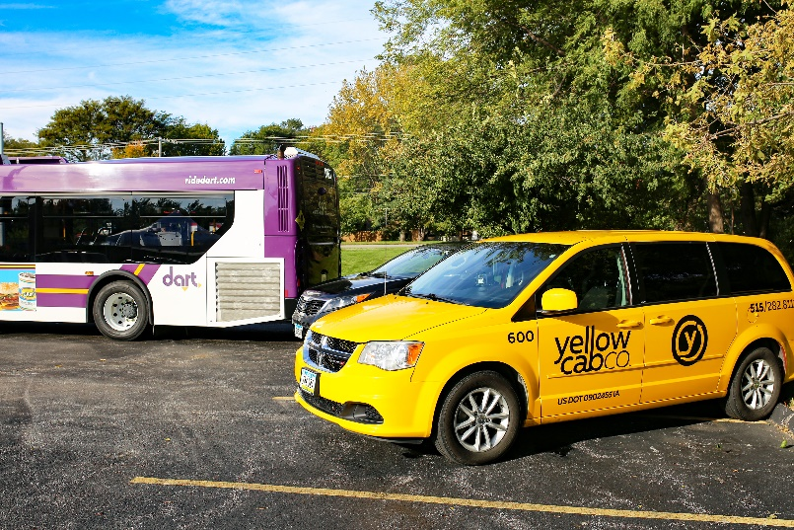
Transportation Services

Slide 8
Flex Connect
Mobility on Demand Pilot
Notes:
Section Header – Century Gothic, 32 pt., white

Slide 9
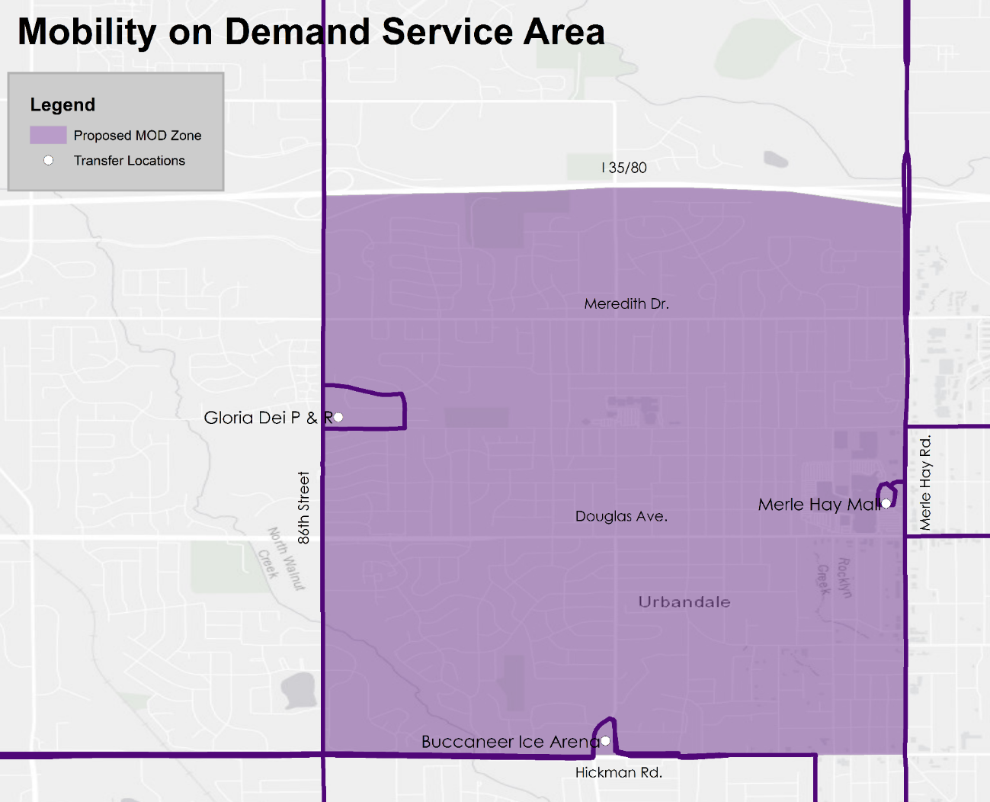
Service Overview
Trips must start or end at one of three DART bus stops:
Gloria Dei Park and Ride (Route 93)
Buccaneer Arena (Route 92)
Merle Hay Mall (Routes 5, 14, 16, 50)
Trip must be within pilot service area
Program available Monday-Friday, 5:30am-6:30pm
Full cost of Flex Connect trip paid by DART, bus fare paid by customer

Slide 10
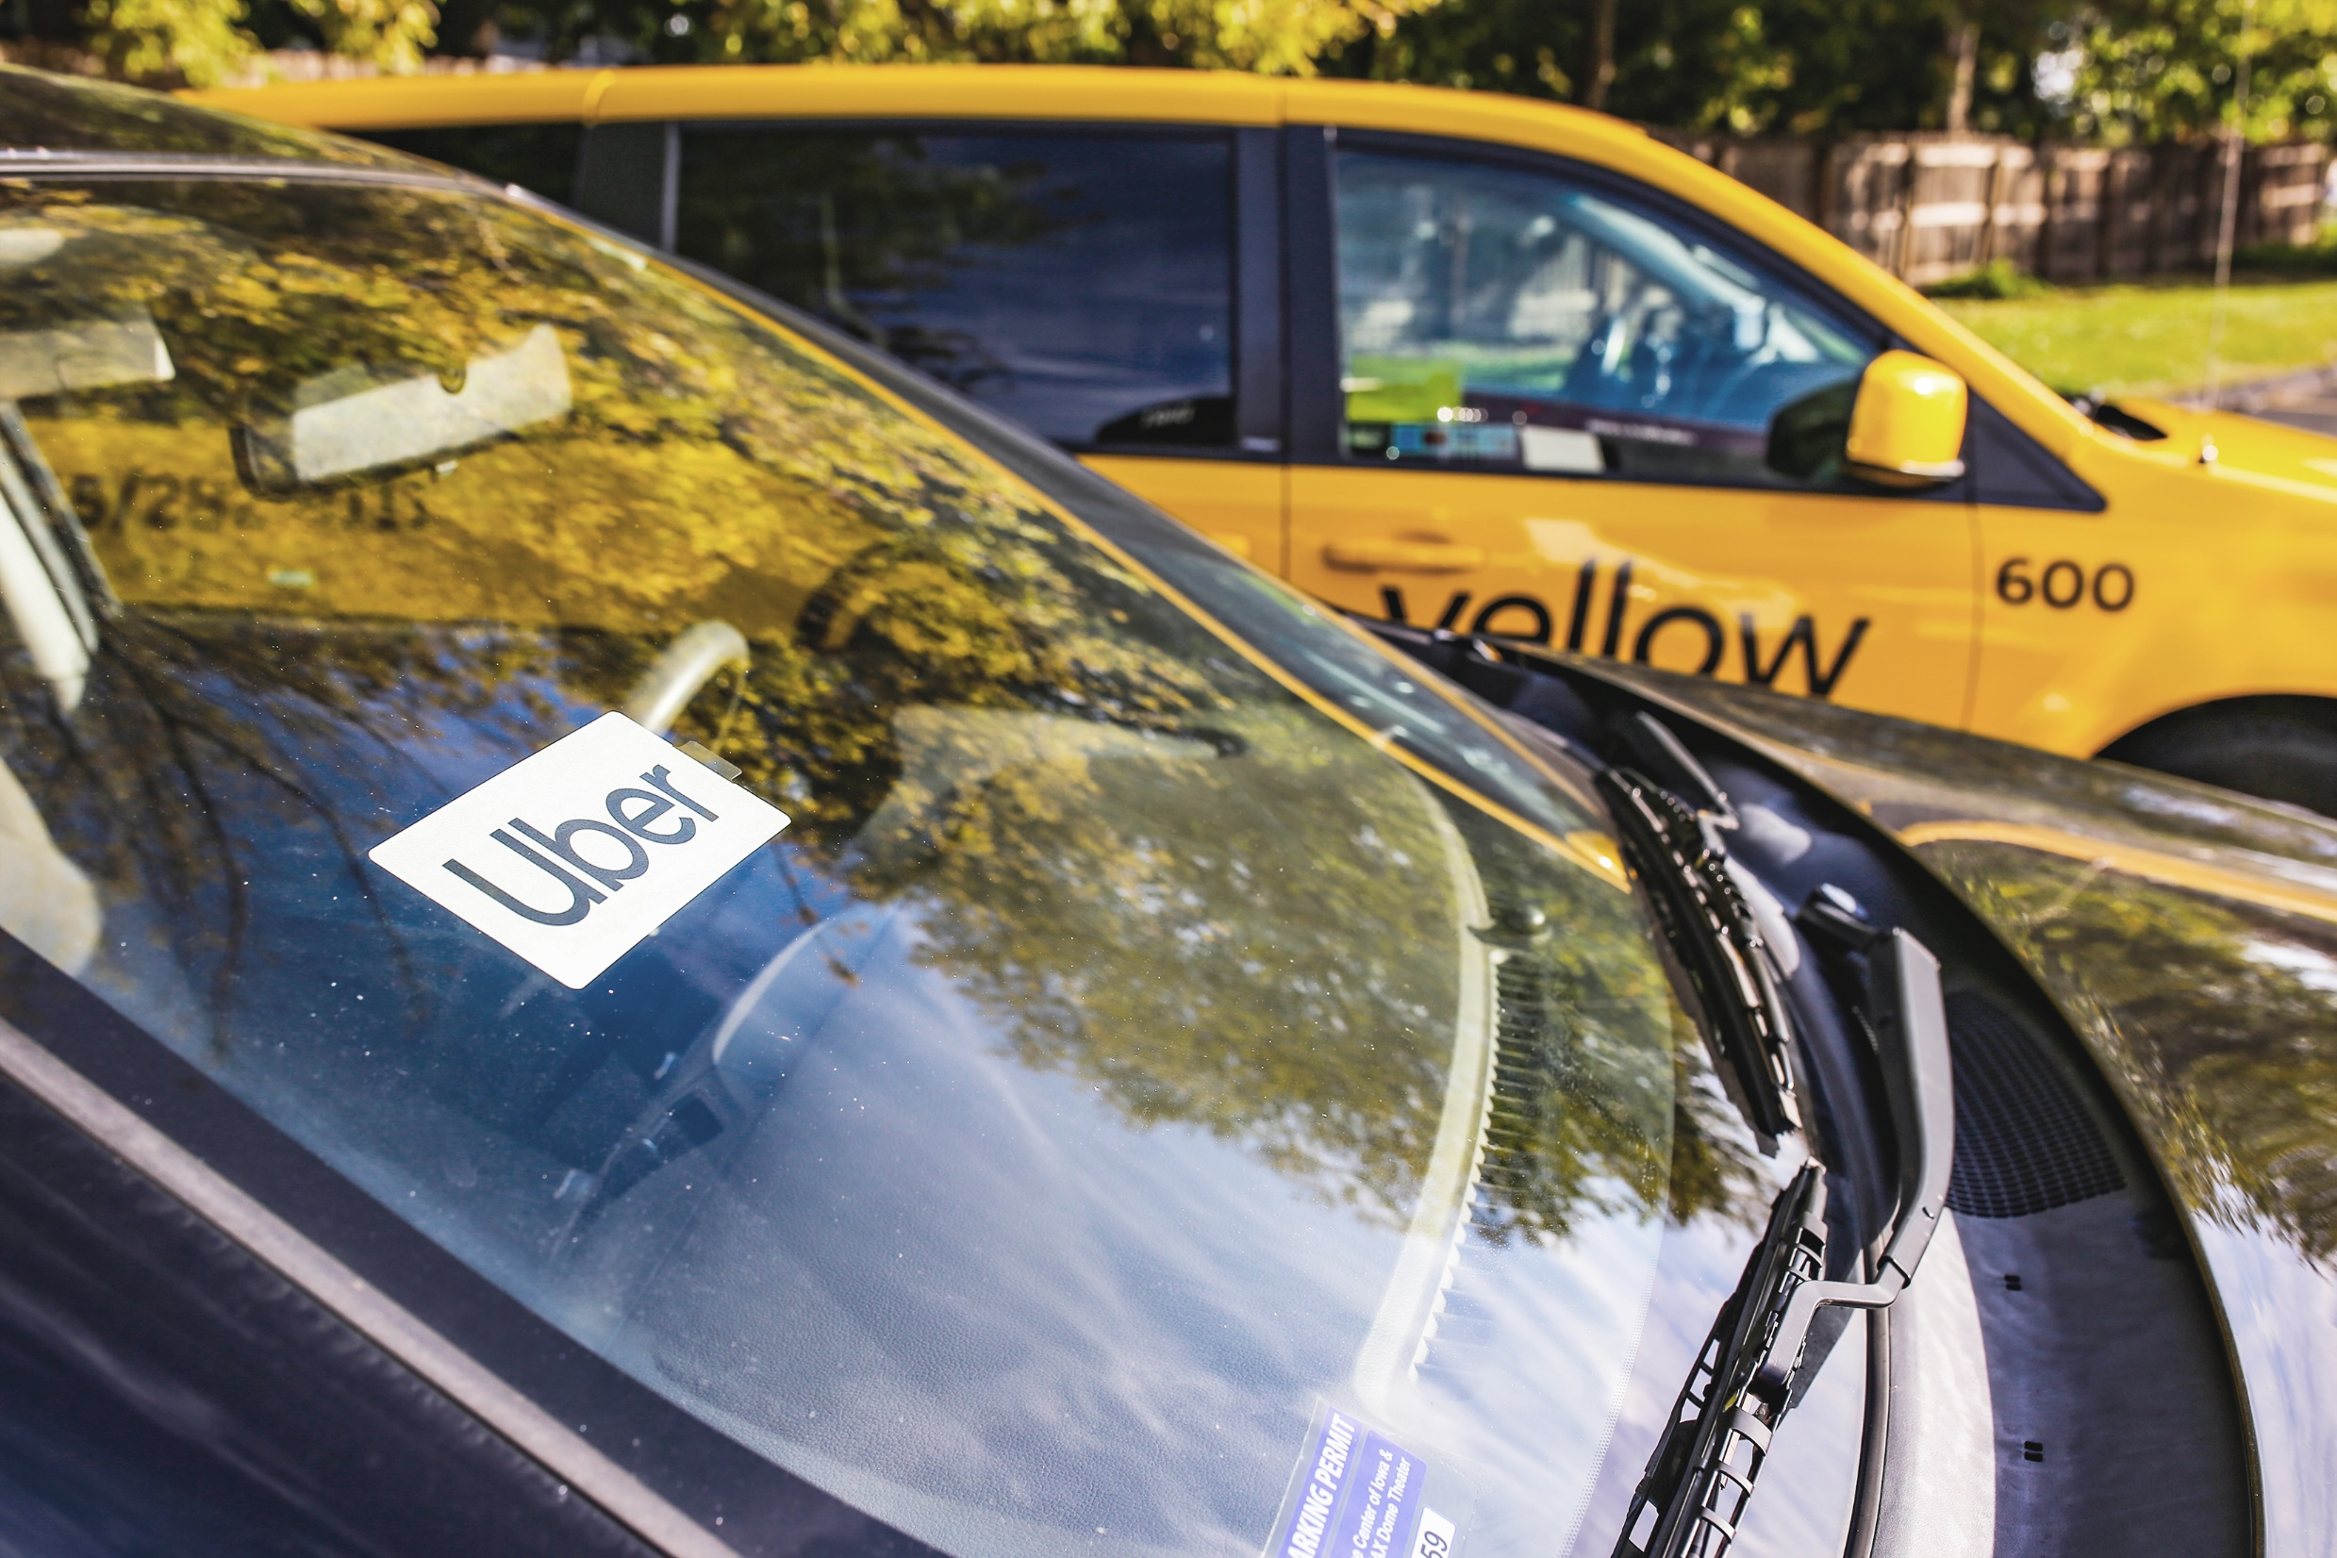
How it works
Customers can choose to be transported by Uber or a local taxi
Customers can book a trip in Uber app or by calling DART customer service
Customers can access Uber vouchers online, by email, and via QR code at select bus stops
Customers requiring a wheelchair lift will be transported by DART

Slide 11
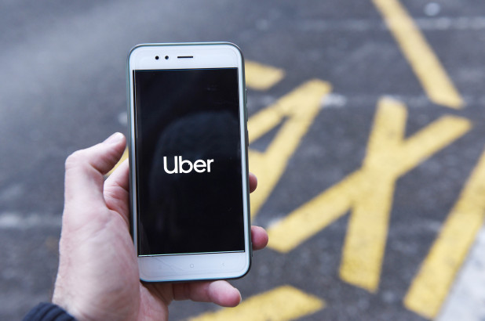
Opportunities to Learn
ADA Accessibility
Technology Integration
Data sharing
Pricing
Procurement
Ridership

Slide 12
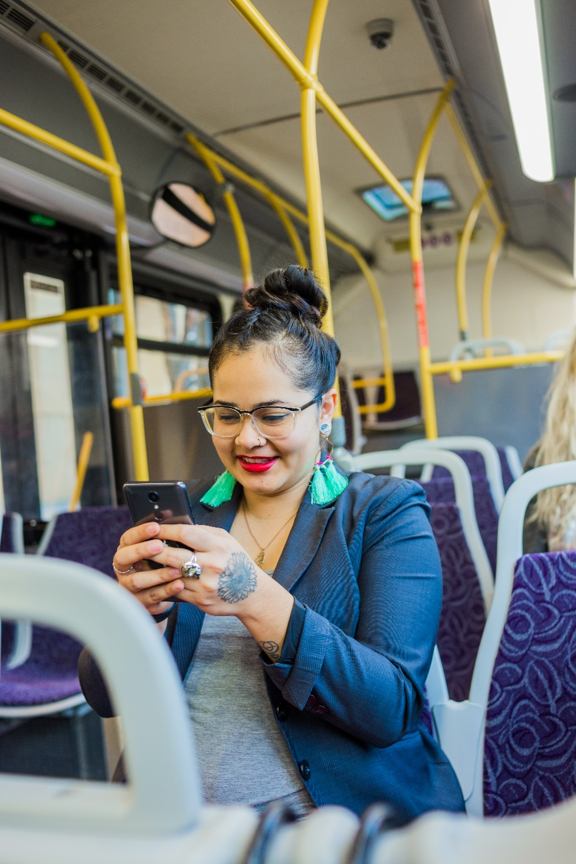
Looking ahead

Slide 13
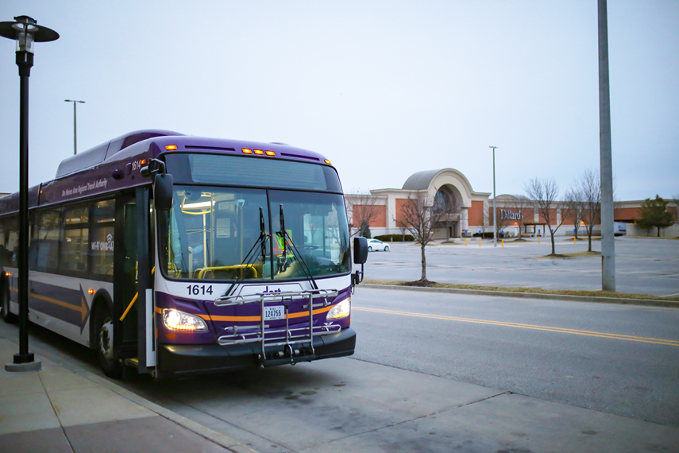
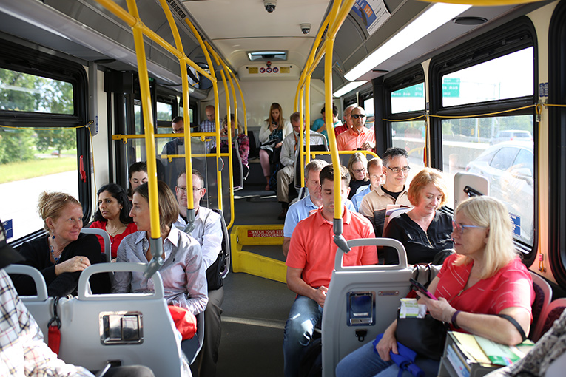
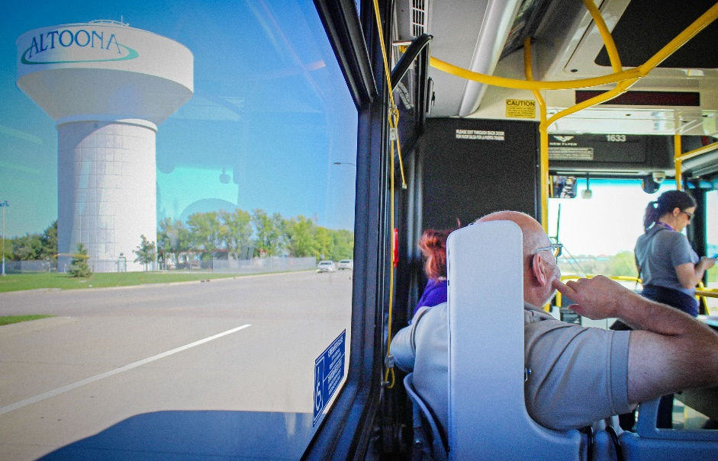
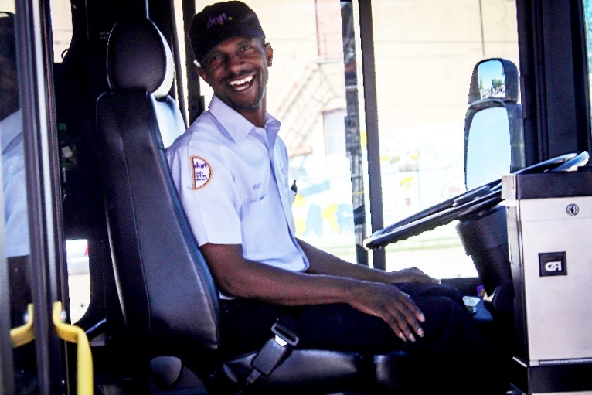
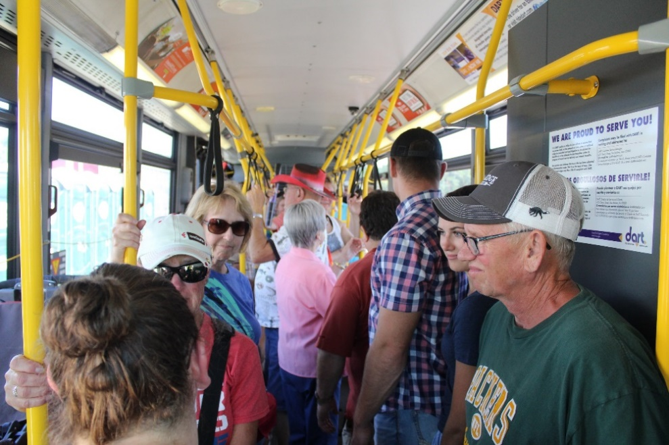
THANK YOU

