Slide 1
Gtsb report
August 2020

Slide 2
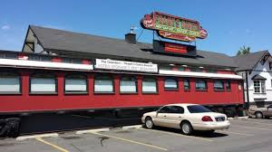
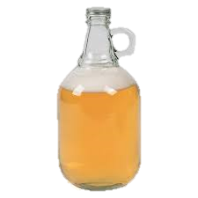
Pandemic policy permanent – Iowa is the first state to sign alcohol to go into law
The Iowa Alcohol and Beverage Division is providing an overview of the new to-go sales law:
Charity Event Permits – special events permits will be allowed on existing premises for consumption of alcohol
Class C Licenses (Bars & Restaurants) and native distilleries can sell mixed drinks, liquor and wine to go
Beer Growlers can now be sold over the phone and online with class C liquor licenses and beer to go sales. In the past, sales were required to be in person.
Wine Growlers will be allowed after administrative rules are drafted (typically 100 days), and can be sold on the phone, in person or online.
Amnesty bill for underage persons who report overconsumption.
Alcohol CANNOT be delivered.

Slide 3
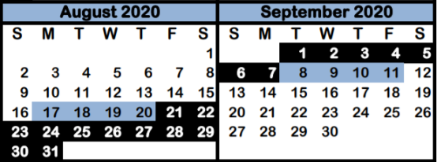
Step wave august 21 – august 31
trafficsafetymarketing.gov

Slide 4
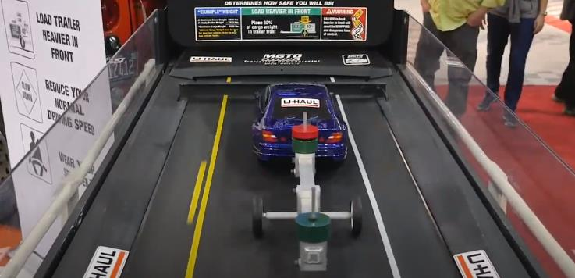
U-Haul offers safe trailering education to communities
Learn How to:
Properly load a trailer – dispersing the weight
What to do if you do lose control of the trailer
- Where do your hands go?
- Should you break?
- Should you speed up?
Upcoming Virtual Event? U-Haul would love to be a part of it!
Contact Lindsay Pobieglo, U-Haul Community Education Program Manager at 480-568-0389 or Lindsay@uhaul.com
Marco Garcia Trailer Demonstrator
https://www.youtube.com/watch?v=qEHD9Wjw3lk

Slide 5
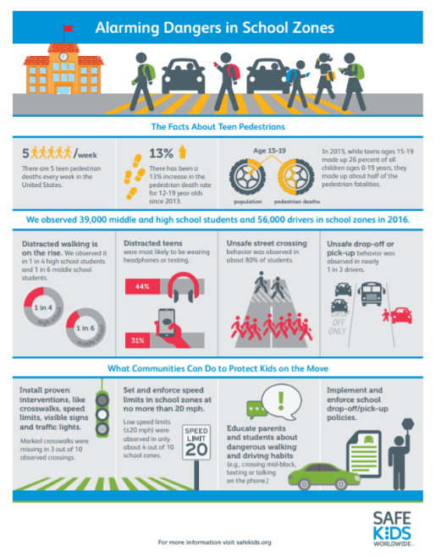
PEDESTRIAN SAFETY

Slide 6
PEDESTRIAN SAFETY

Slide 7
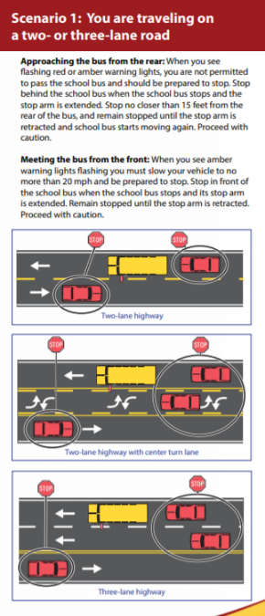
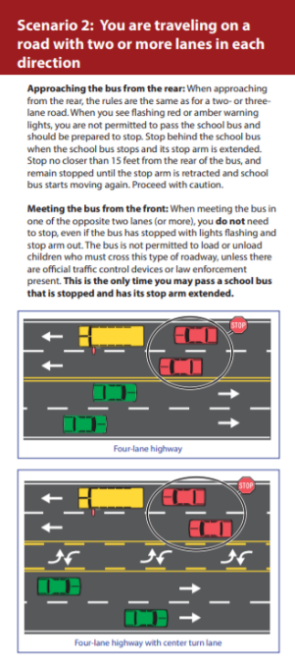
SCHOOL BUS SAFETY (For DRIVERS)

Slide 8
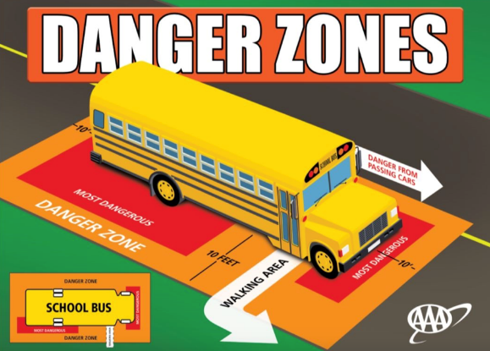
SCHOOL BUS SAFETY (For KIDDOS)

Slide 9
Virtual iowa state fair 2020

Slide 10
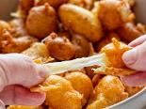
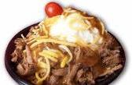
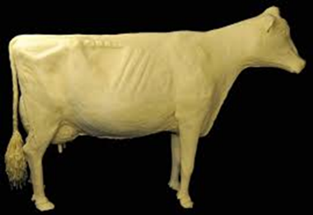
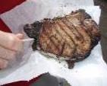
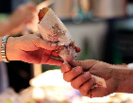
FOOD | VENDOR | PERCENT OF VOTES
5. Deep-Fried Cheese Curds | Multiple | 5.6 %
4. Hot Beef Sundae | Cattleman’s Beef Quarters | 6.2 %
3. Peppermint Bar | Bauder’s Ice Cream | 8.1%
2. Pork Chop on a Stick | Iowa Pork Tent | 13.0 %
Corn Dog | Multiple | 27.3%
TOP 5 Iowa State Fair Foods Did Your Fav Make the List?

Slide 12
QUESTIONS?

